Slide 1
xFusion2288H V7 Server Guide

Slide 2
목 차
System Infromation 1) CPU Check 2) Memory Check 3) BIOS Version Check
Key Parameters 1) Processor Configuration 2) Memory Configuration 3) PCIe/IO Settings 4) Power Management 5) Security Features
Device Manager 1) Cable Check 2) HardDisk Check 3) Raid Configuration
Management Features 1) BMC Set
Troublehooting 1) BIOS Clear 2) Event Logging

Slide 3
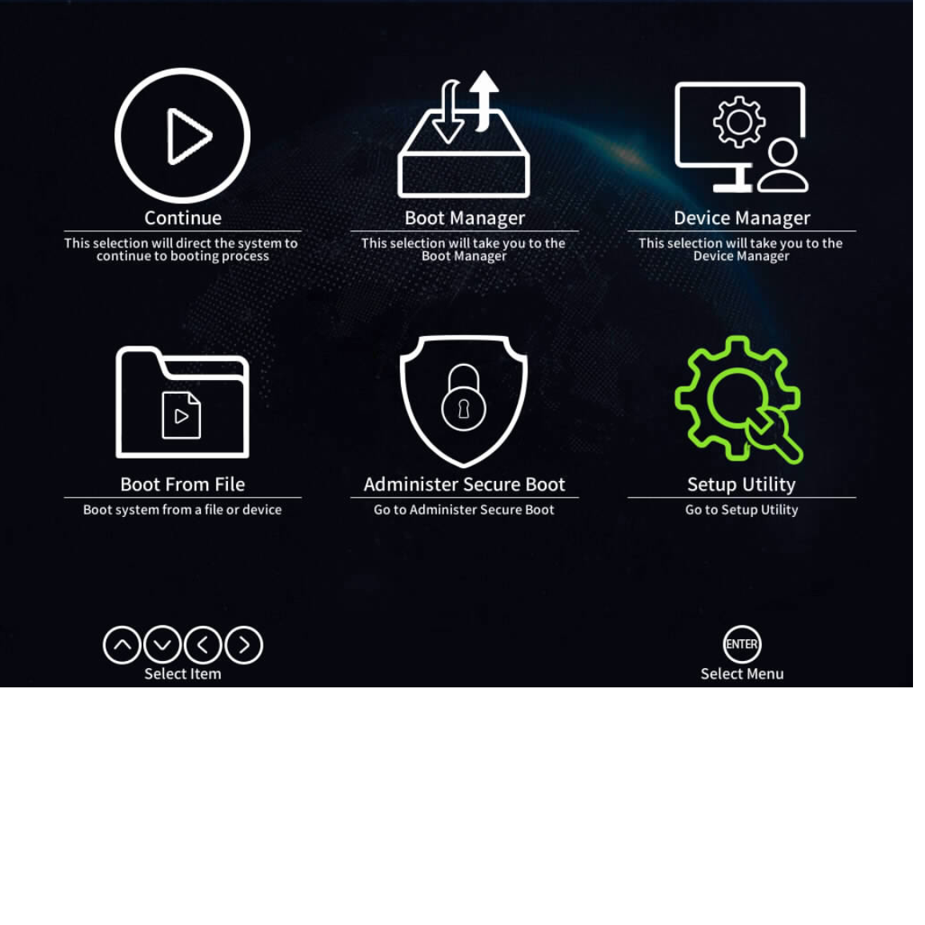
System Information
CPU Check
Memory Check
BIOS Version Check

Slide 4
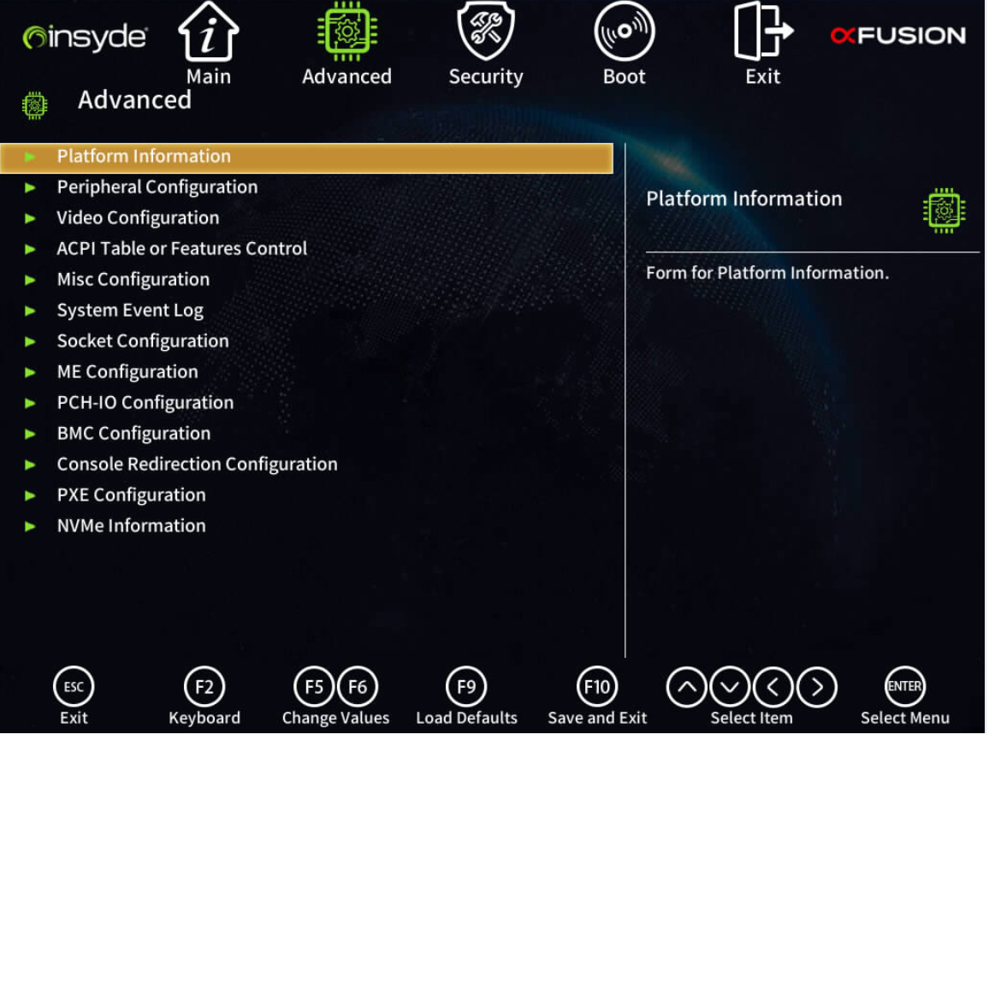
System Information
CPU Check - Socket Configuration
Memory Check
BIOS Version Check

Slide 5
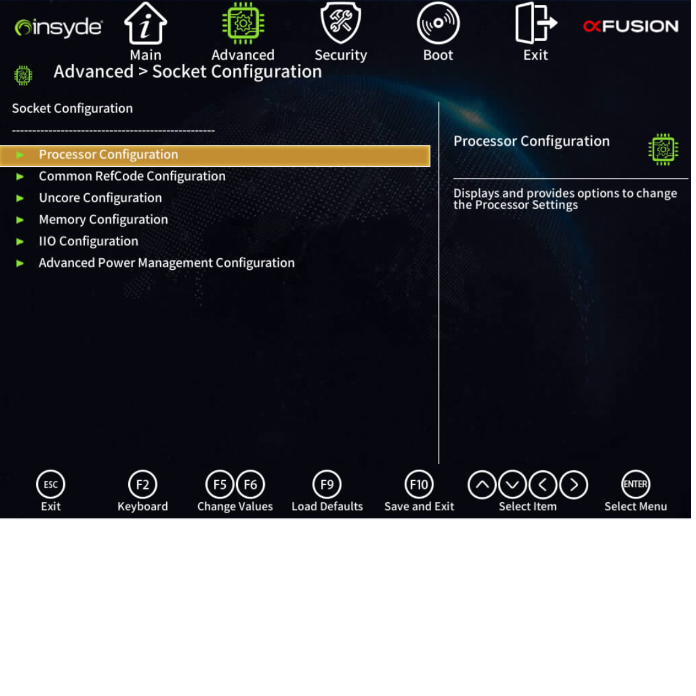
System Information
CPU Check - Processor Configuration
Memory Check
BIOS Version Check

Slide 6
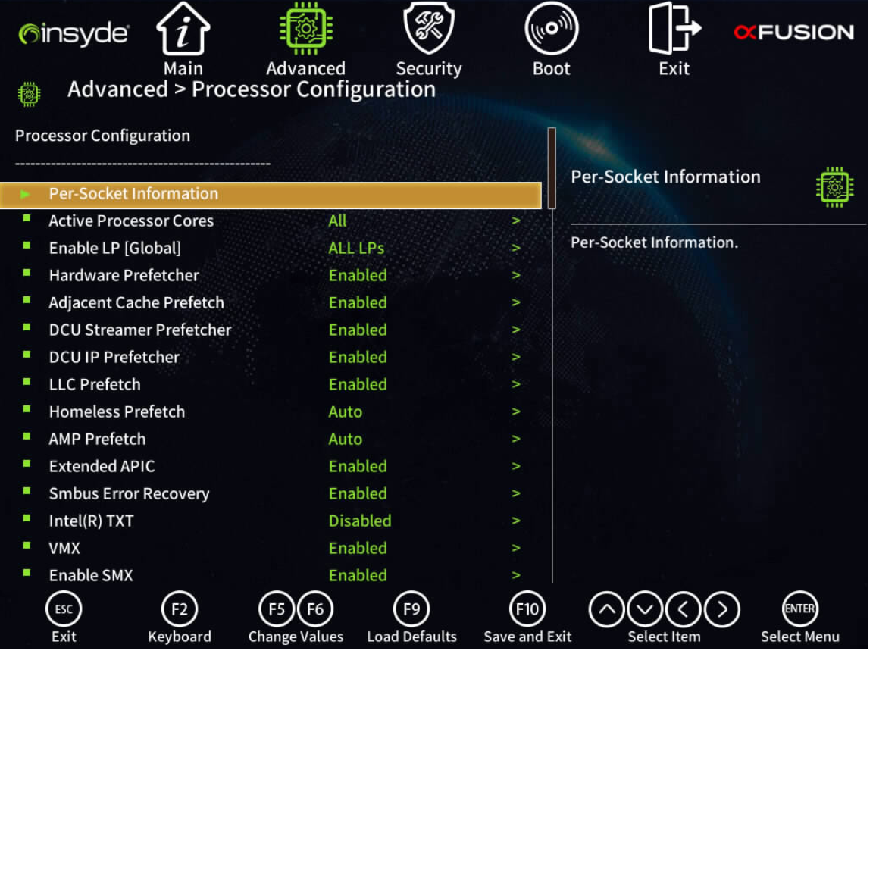
System Information
CPU Check - Per-Socker information
Memory Check
BIOS Version Check

Slide 7
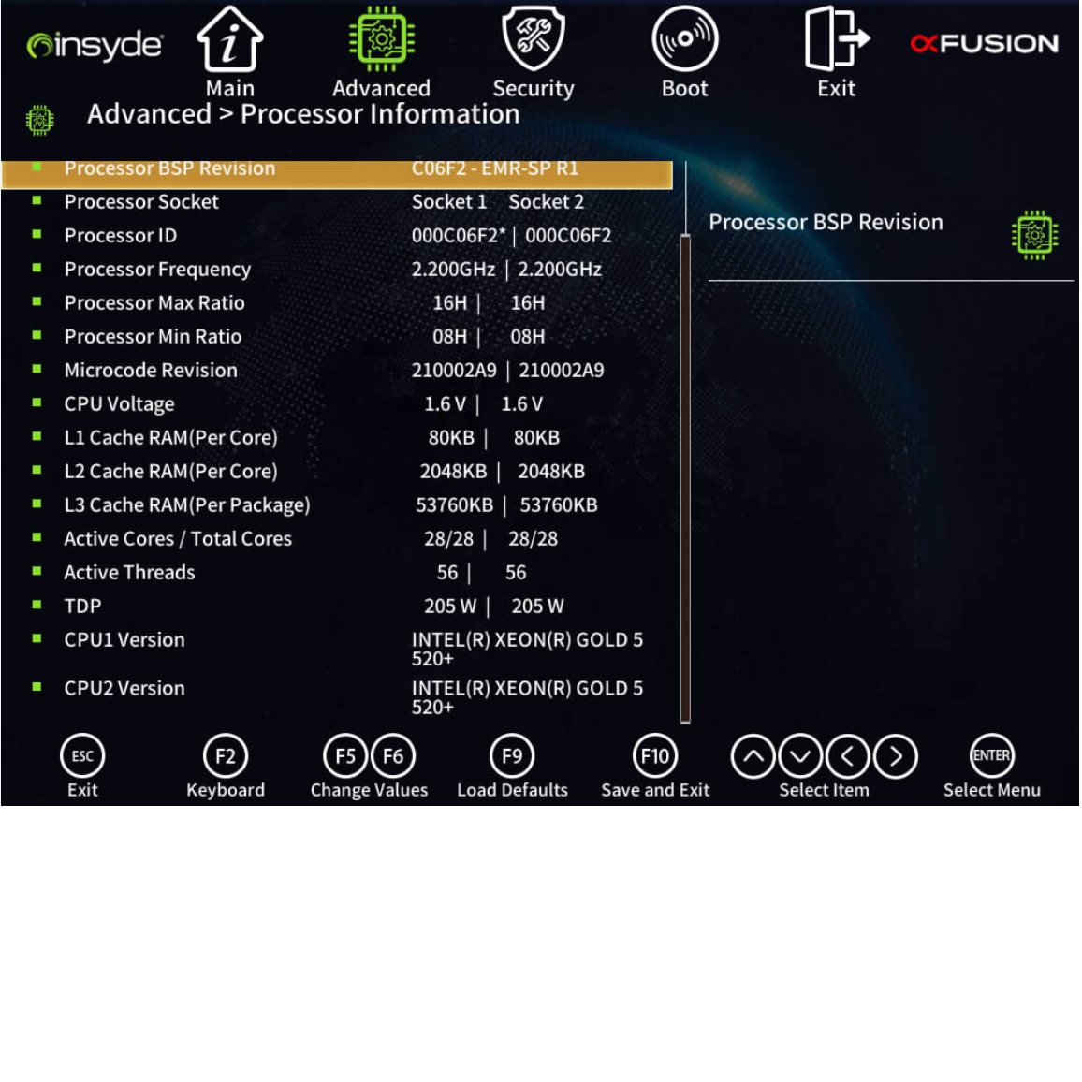
System Information
CPU Check - CPU Type Version Check
Memory Check
BIOS Version Check

Slide 8
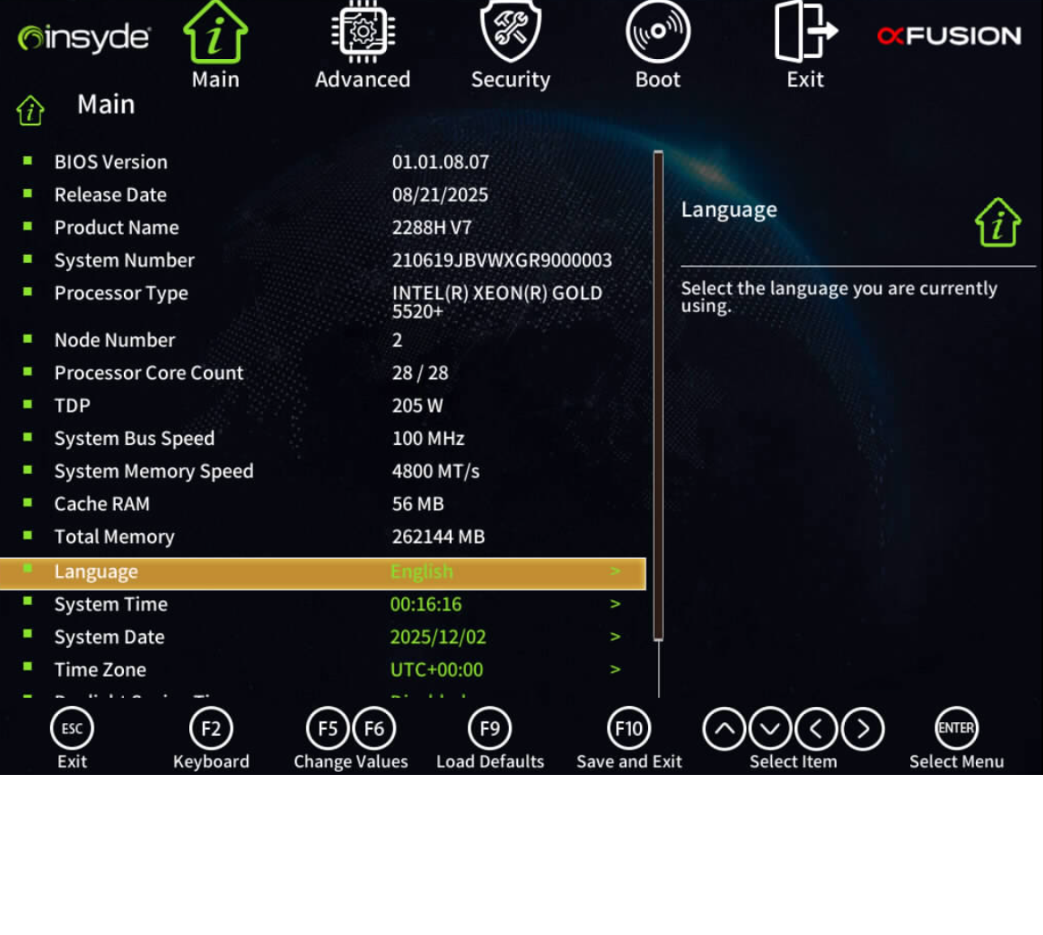
System Information
CPU Check
Memory Check - Main 에서 확인 가능
BIOS Version Check

Slide 9
System Information
CPU Check
Memory Check
BIOS Version Check - Main에서 확인 가능

Slide 10
Key Parameters
Processor Configuration - Socket Configuration
Memory Configuration
PCIe/IO Settings
Power Management
Security Features

Slide 11
Key Parameters
Processor Configuration - Processor Configuration
Memory Configuration
PCIe/IO Settings
Power Management
Security Features

Slide 12
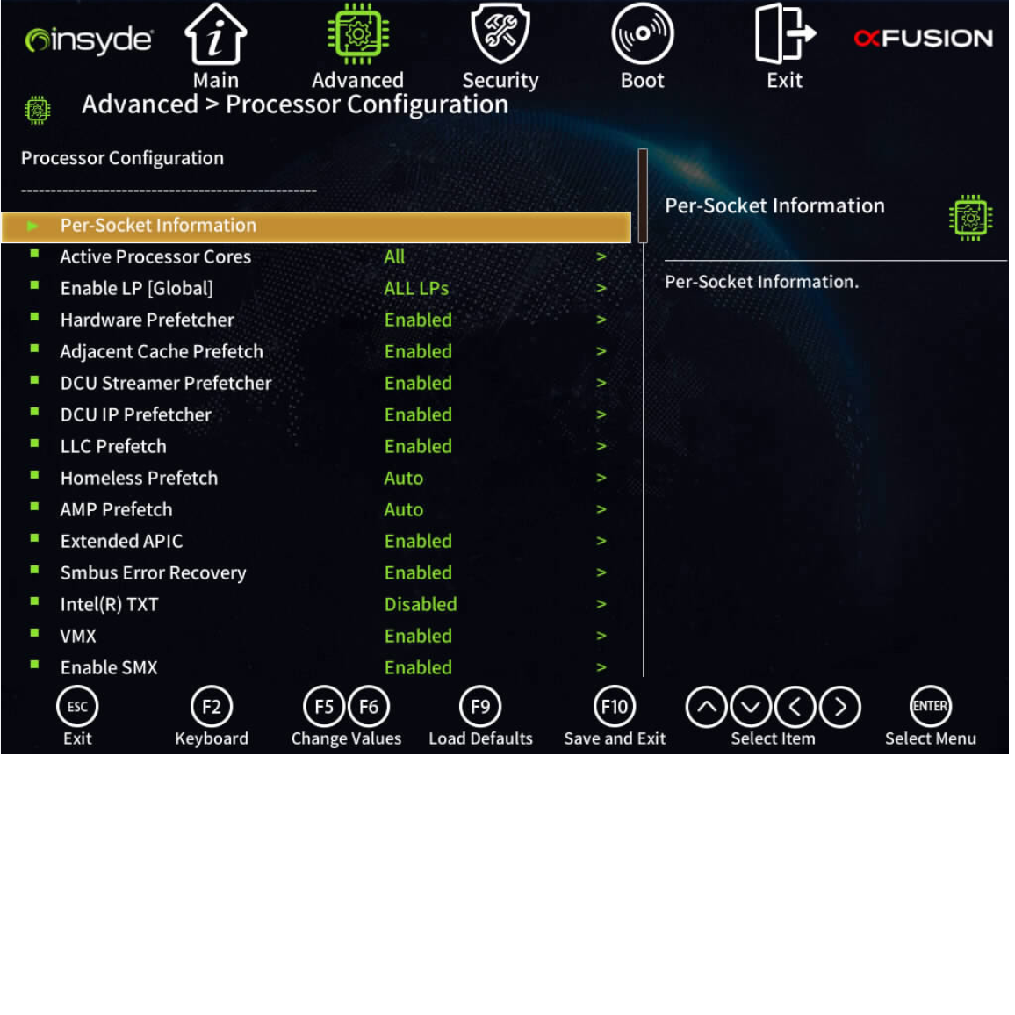
Key Parameters
Processor Configuration - 활성화된 프로세서 코어 수, VMX등 확인 가능
Memory Configuration
PCIe/IO Settings
Power Management
Security Features

Slide 13
Key Parameters
Processor Configuration
Memory Configuration - Socket Configuration
PCIe/IO Settings
Power Management
Security Features

Slide 14
Key Parameters
Processor Configuration
Memory Configuration - Memory Configuration
PCIe/IO Settings
Power Management
Security Features

Slide 15
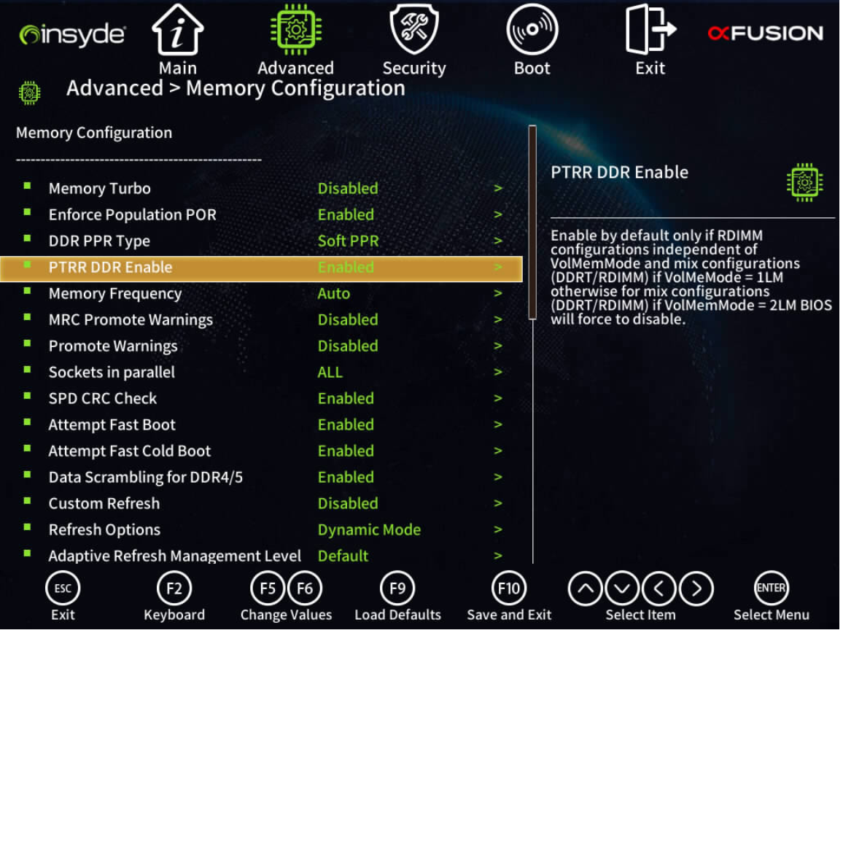
Key Parameters
Processor Configuration
Memory Configuration
PCIe/IO Settings
Power Management
Security Features

Slide 16
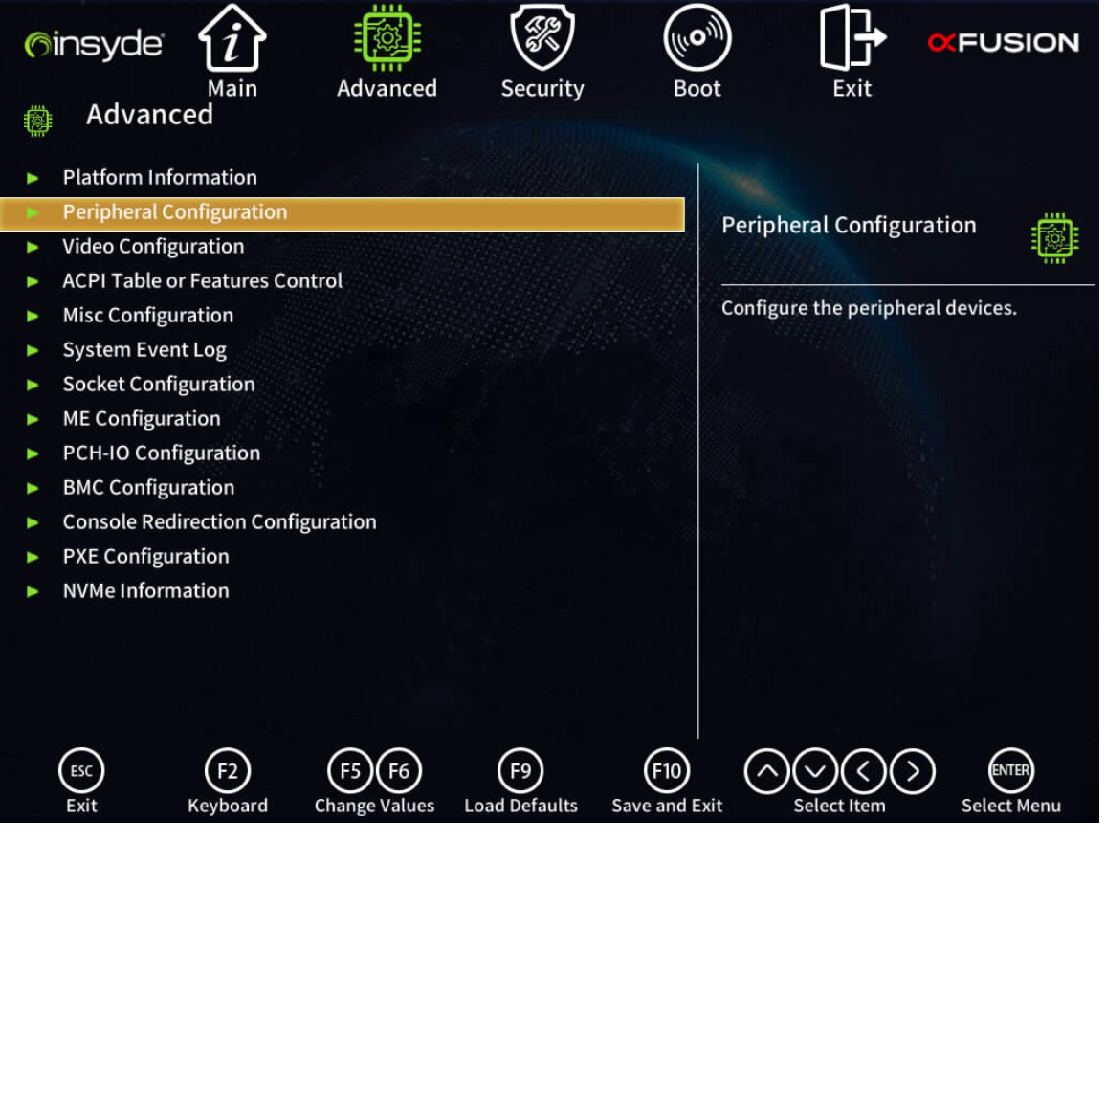
Key Parameters
Processor Configuration
Memory Configuration
PCIe/IO Settings - Peripheral Configuration
Power Management
Security Features

Slide 17
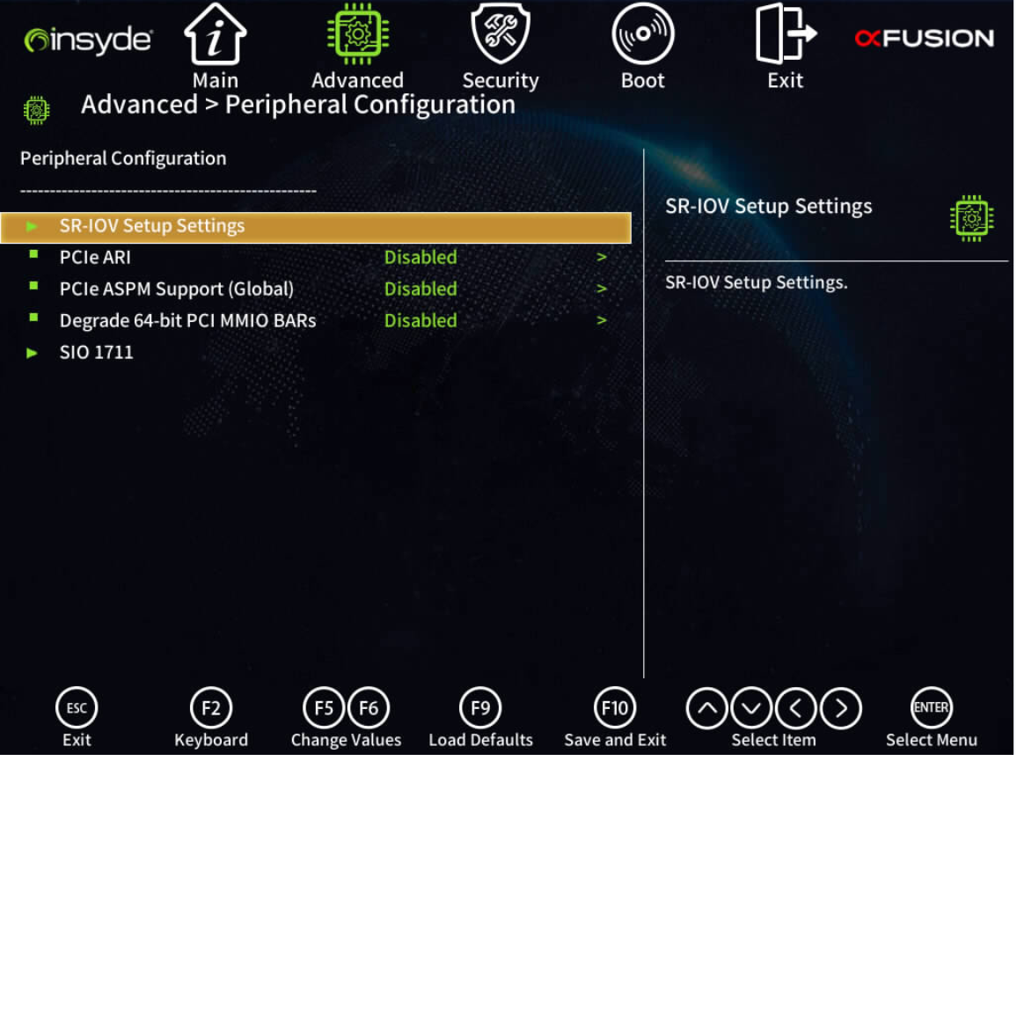
Key Parameters
Processor Configuration
Memory Configuration
PCIe/IO Settings
Power Management
Security Features

Slide 18
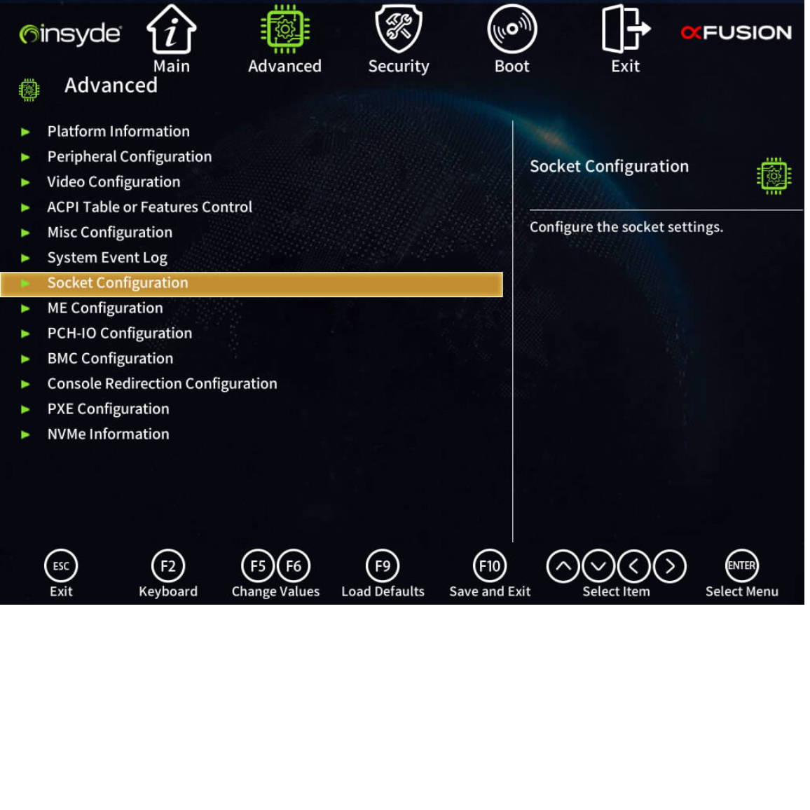
Key Parameters
Processor Configuration
Memory Configuration
PCIe/IO Settings
Power Management - Socket Configuration
Security Features

Slide 19
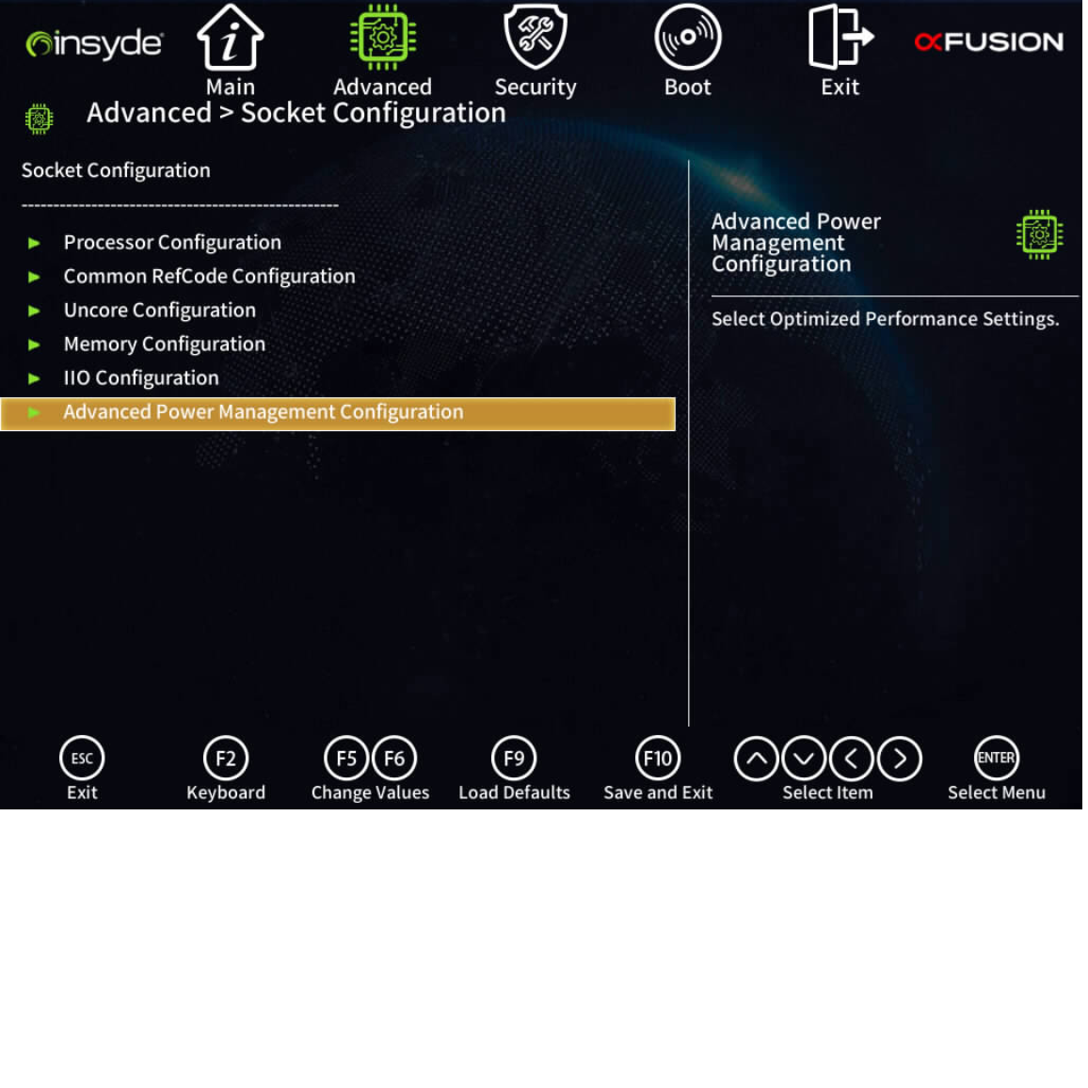
Key Parameters
Processor Configuration
Memory Configuration
PCIe/IO Settings
Power Management - Advanced Power Management Configuration
Security Features

Slide 20
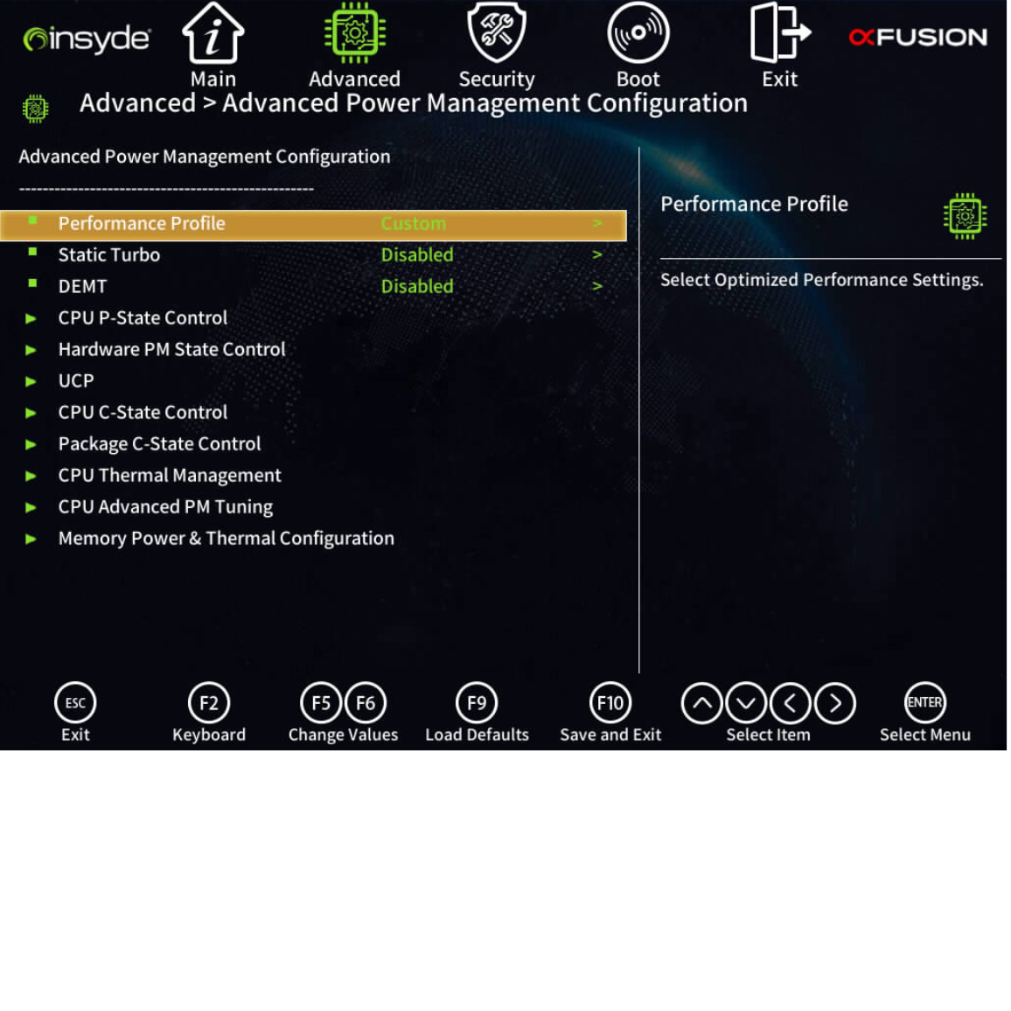
Key Parameters
Processor Configuration
Memory Configuration
PCIe/IO Settings
Power Management - CPU 온도 관리, 메모리 전력 및 열 구성등
Security Features

Slide 21
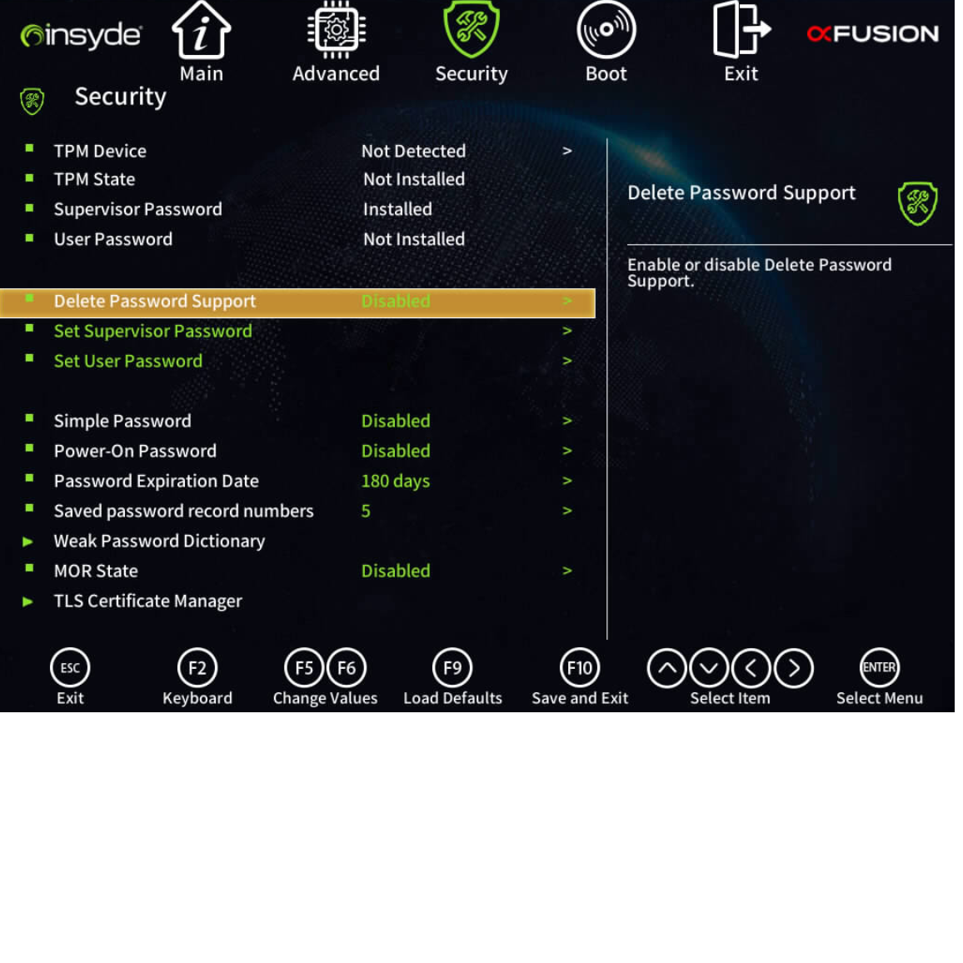
Key Parameters
Processor Configuration
Memory Configuration
PCIe/IO Settings
Power Management
Security Features - BIOS Password Remove and Set

Slide 22
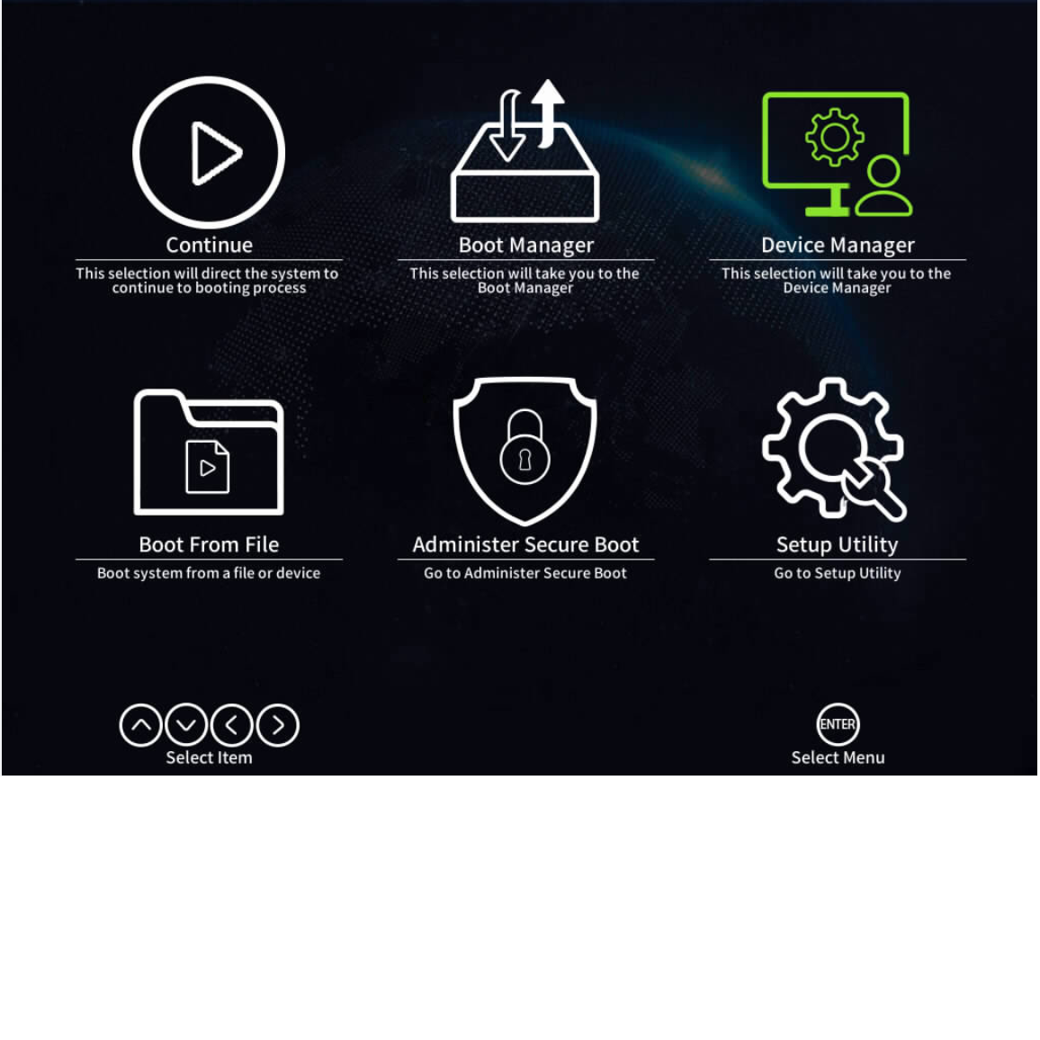
Device Manager
Cable Check
HardDisk Check
Raid Configuration

Slide 23
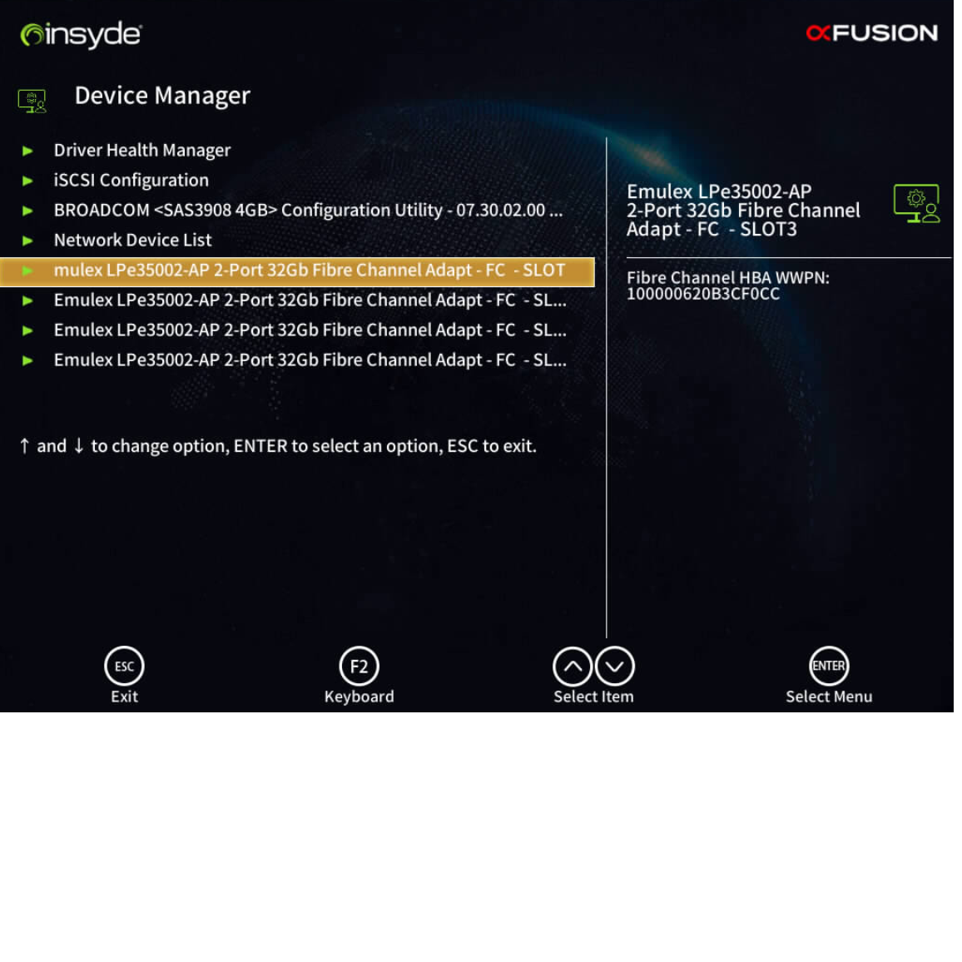
Device Manager
Cable Check
HardDisk Check
Raid Configuration

Slide 24
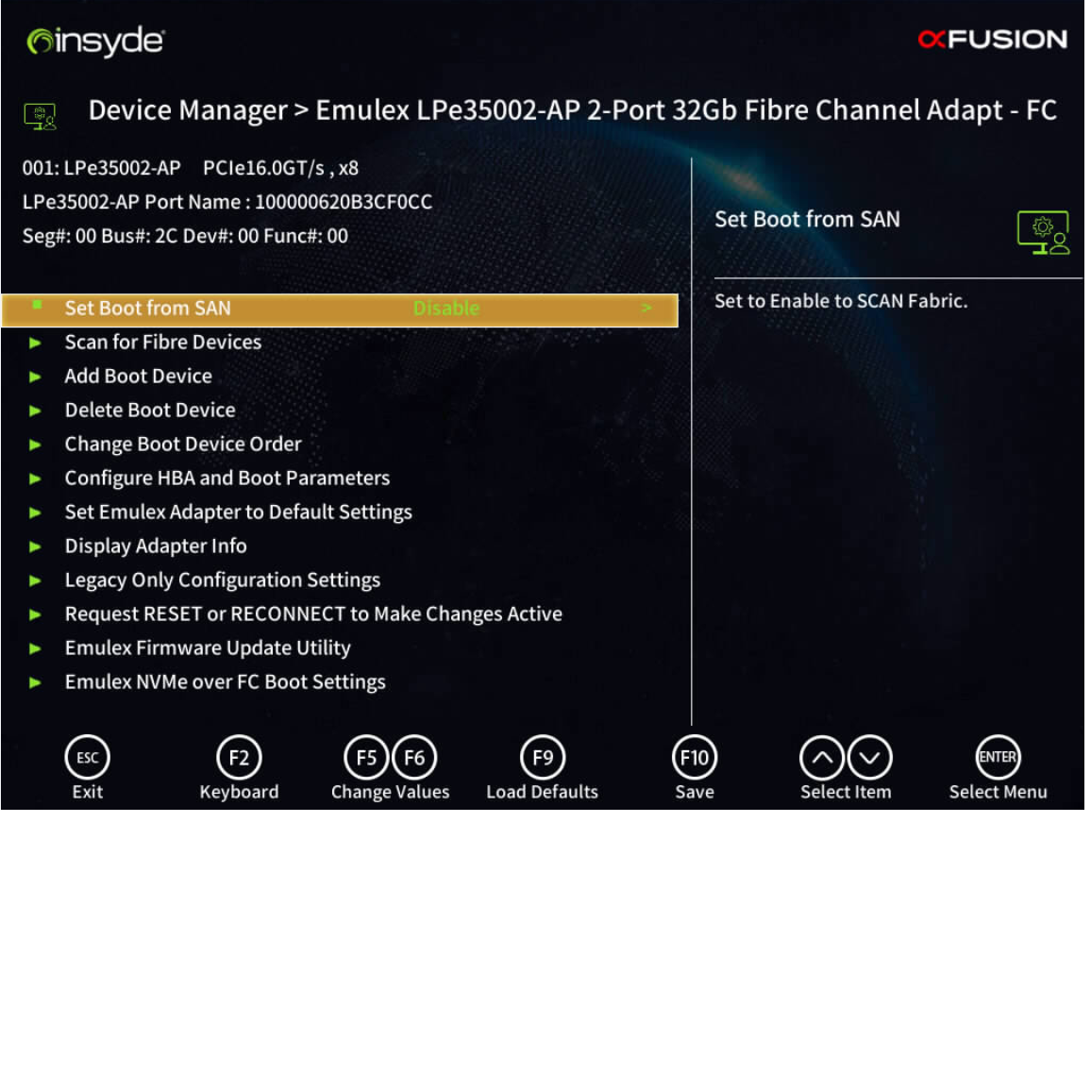
Device Manager
Cable Check
HardDisk Check
Raid Configuration

Slide 25
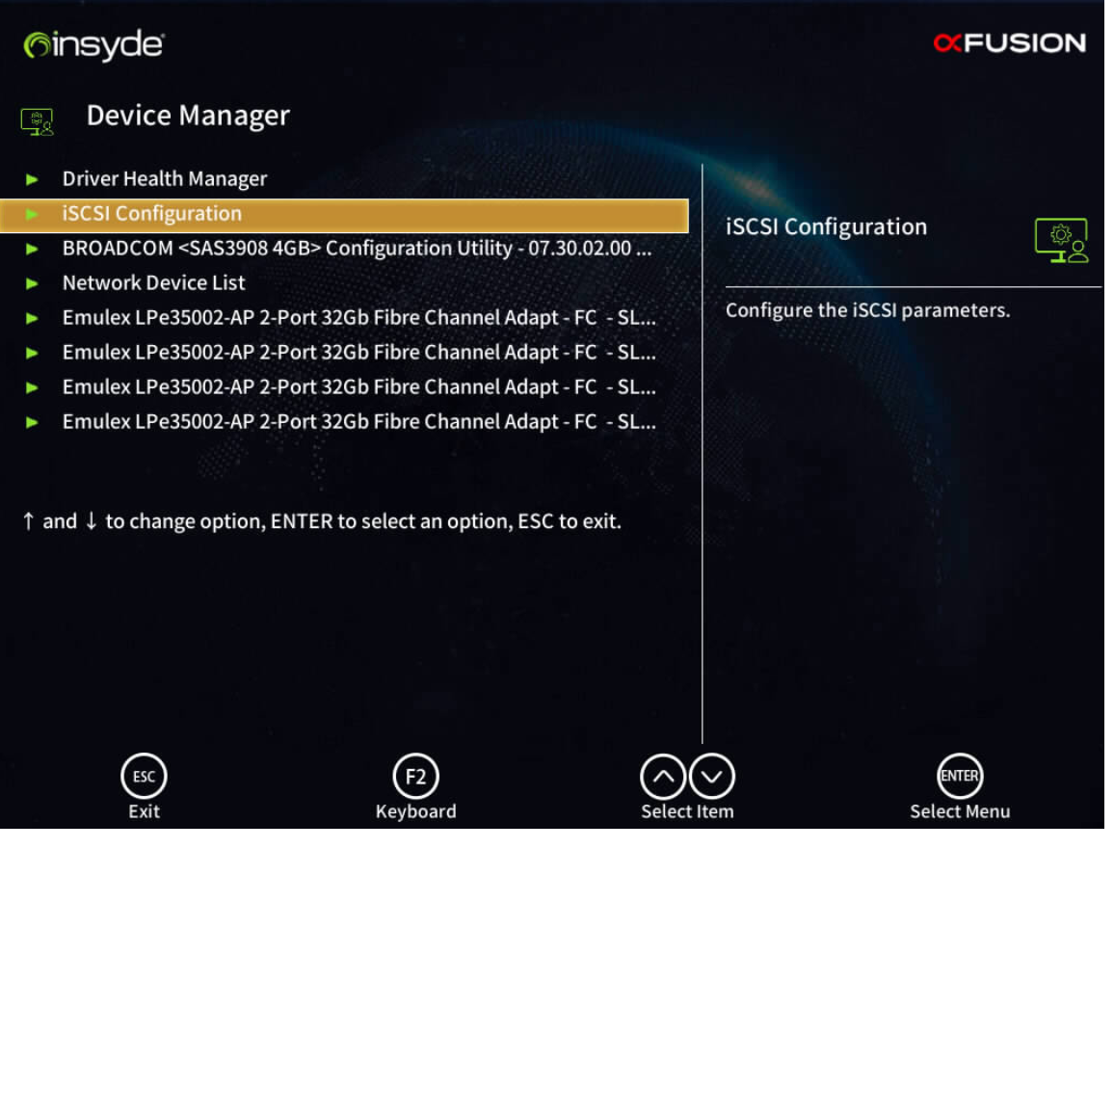
Device Manager
Cable Check
HardDisk Check
Raid Configuration

Slide 26
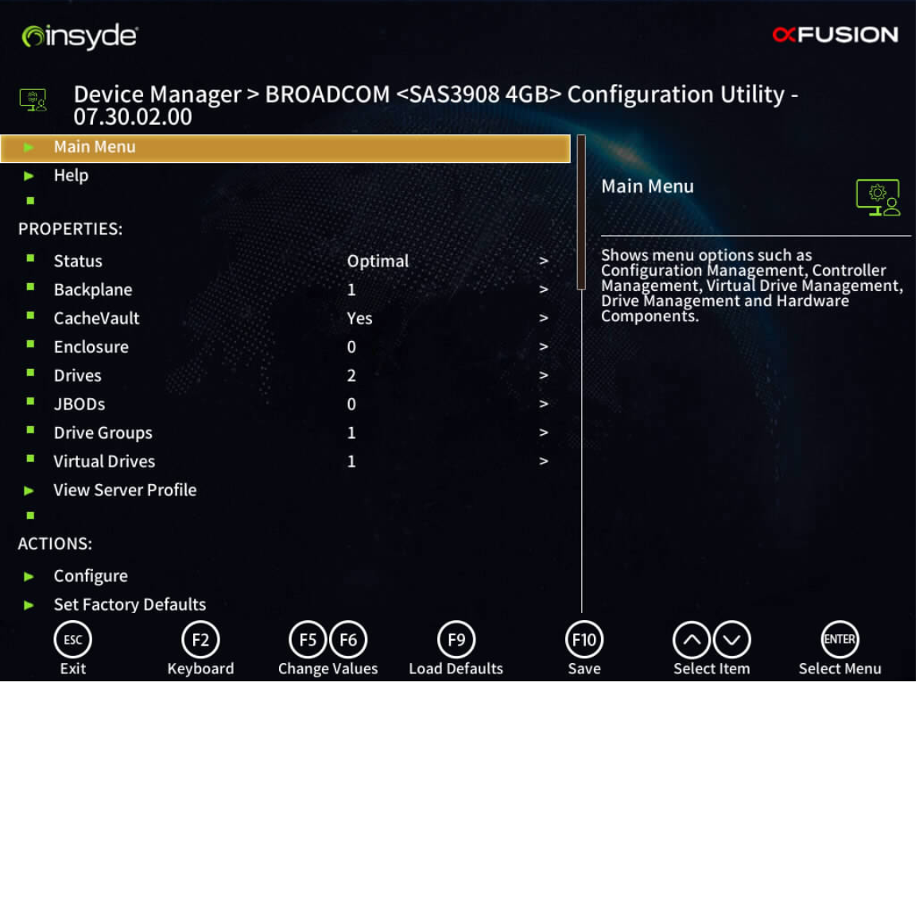
Device Manager
Cable Check
HardDisk Check
Raid Configuration

Slide 27
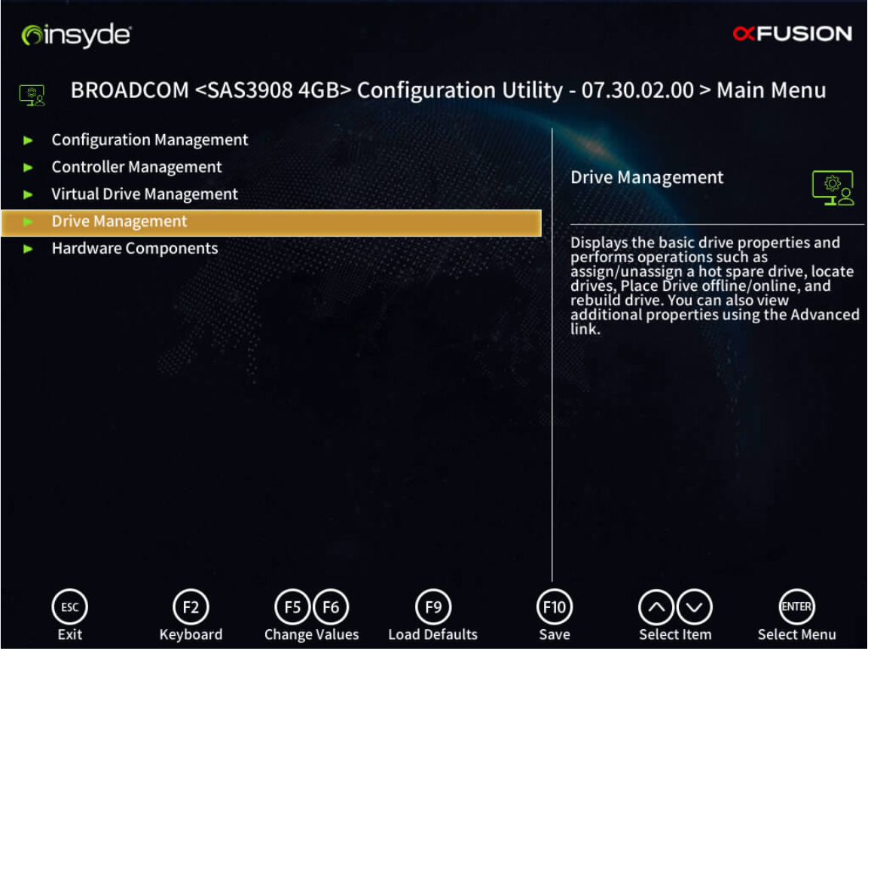
Device Manager
Cable Check
HardDisk Check
Raid Configuration

Slide 28
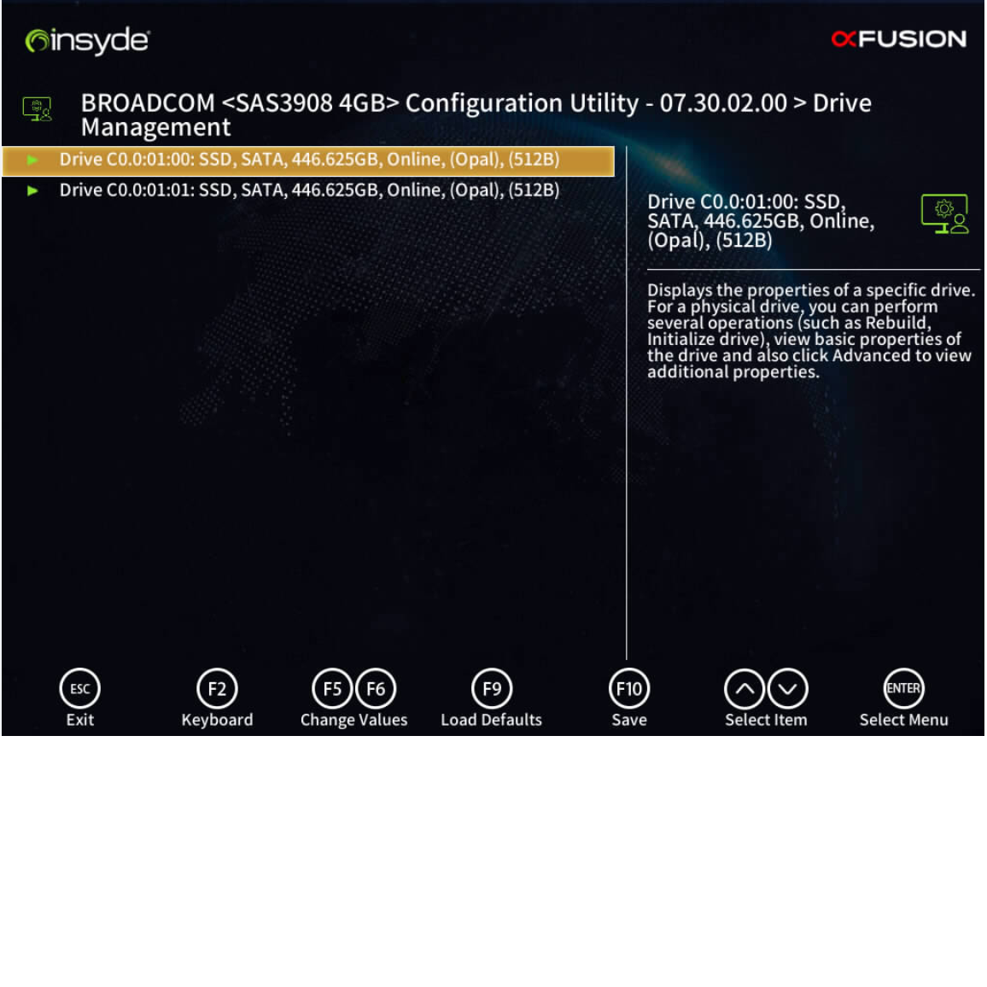
Device Manager
Cable Check
HardDisk Check
Raid Configuration

Slide 29
Device Manager
Cable Check
HardDisk Check
Raid Configuration

Slide 30
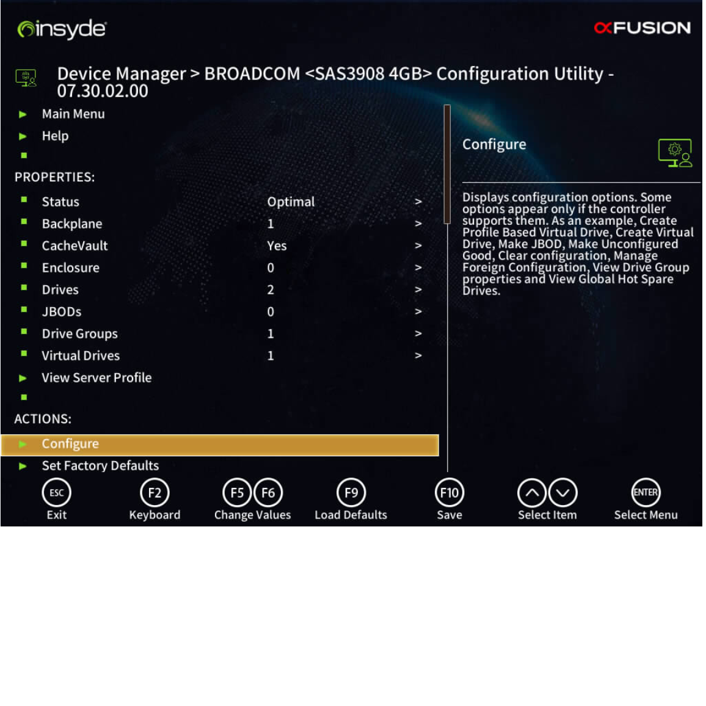
Device Manager
Cable Check
HardDisk Check
Raid Configuration

Slide 31
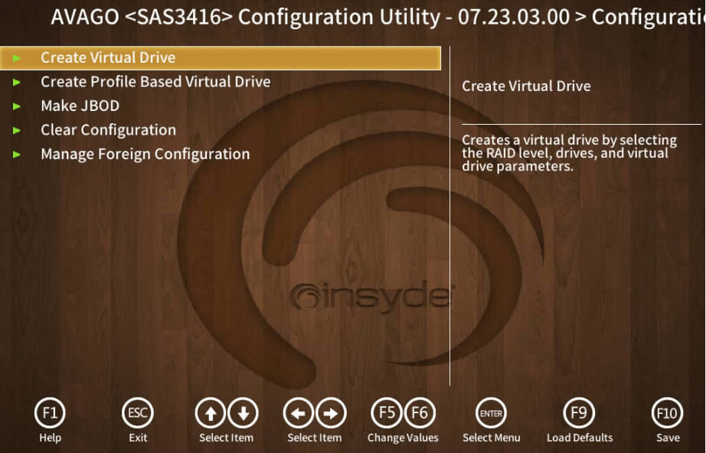
Device Manager
Cable Check
HardDisk Check
Raid Configuration -Create Virtual Drive

Slide 32
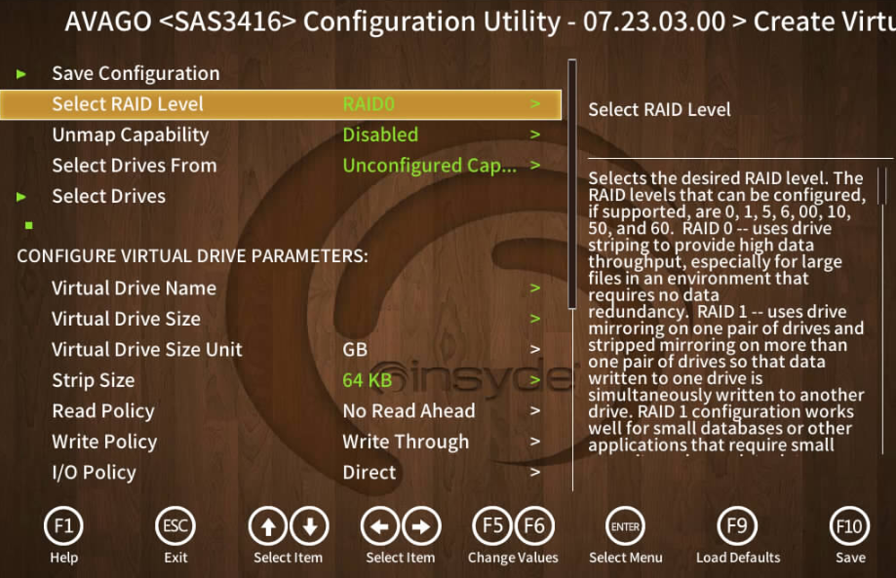
Device Manager
Cable Check
HardDisk Check
Raid Configuration - Select Raid Level - Select Drives

Slide 33
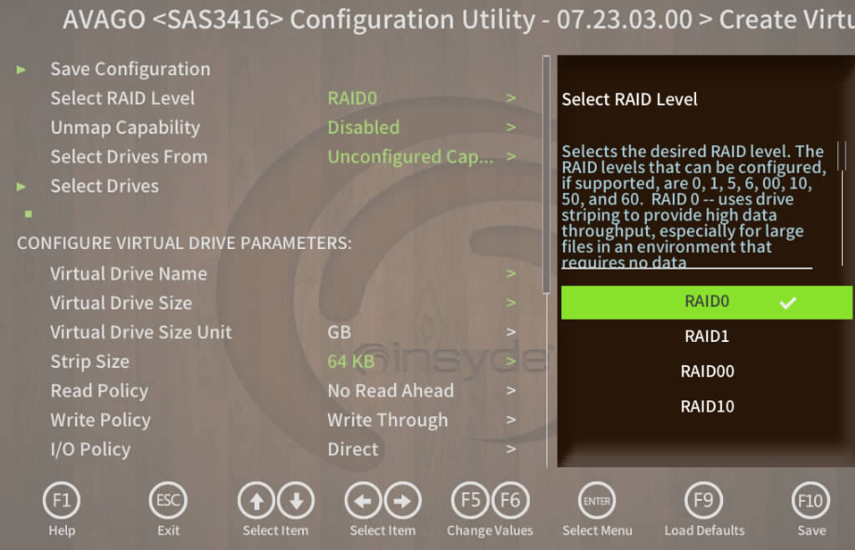
Device Manager
Cable Check
HardDisk Check
Raid Configuration

Slide 34
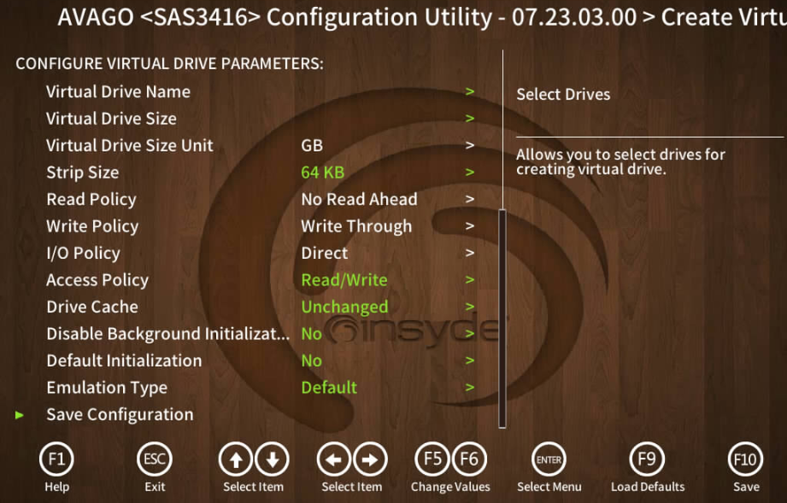
Device Manager
Cable Check
HardDisk Check
Raid Configuration - Save Configuration - F10 (Save)

Slide 35
Management Features
BMC Set

Slide 36
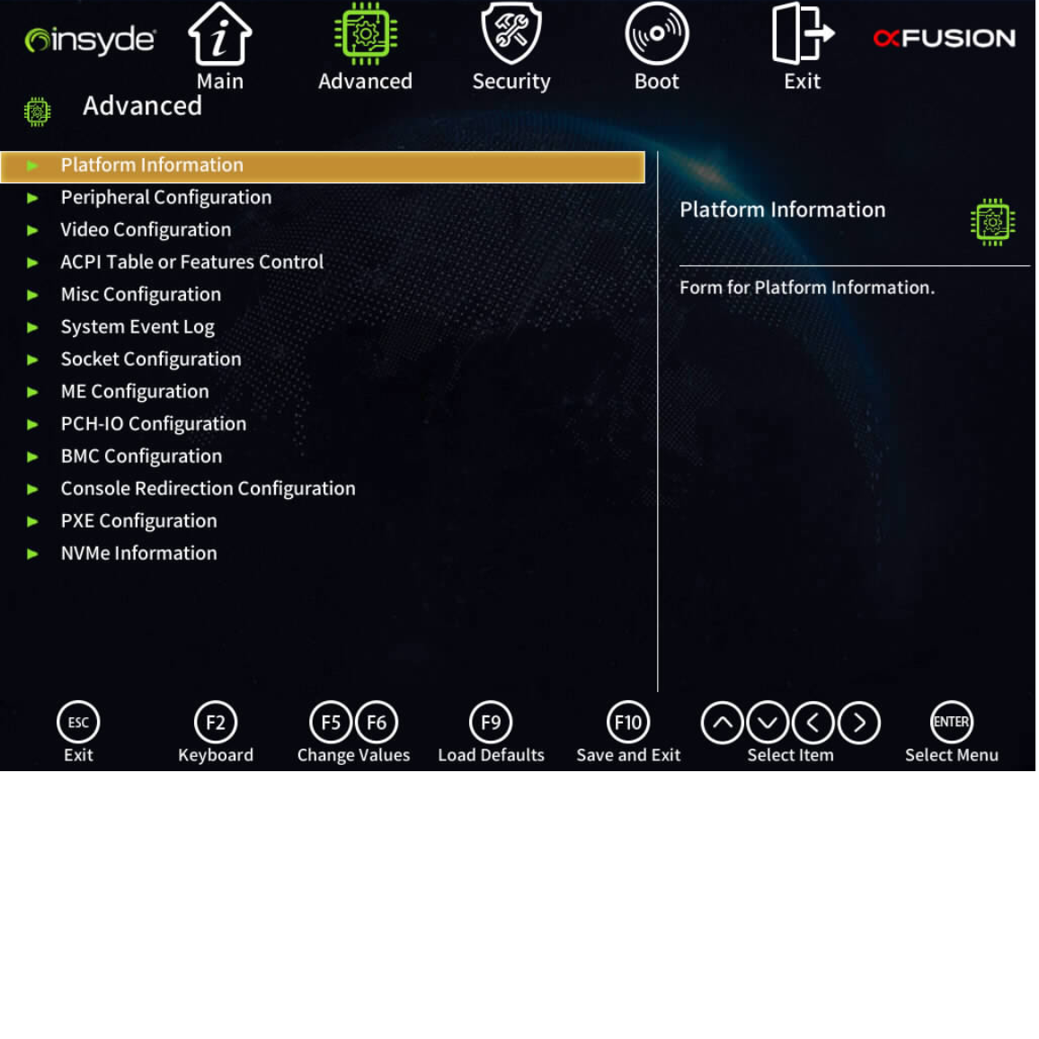
Management Features
BMC Set

Slide 37
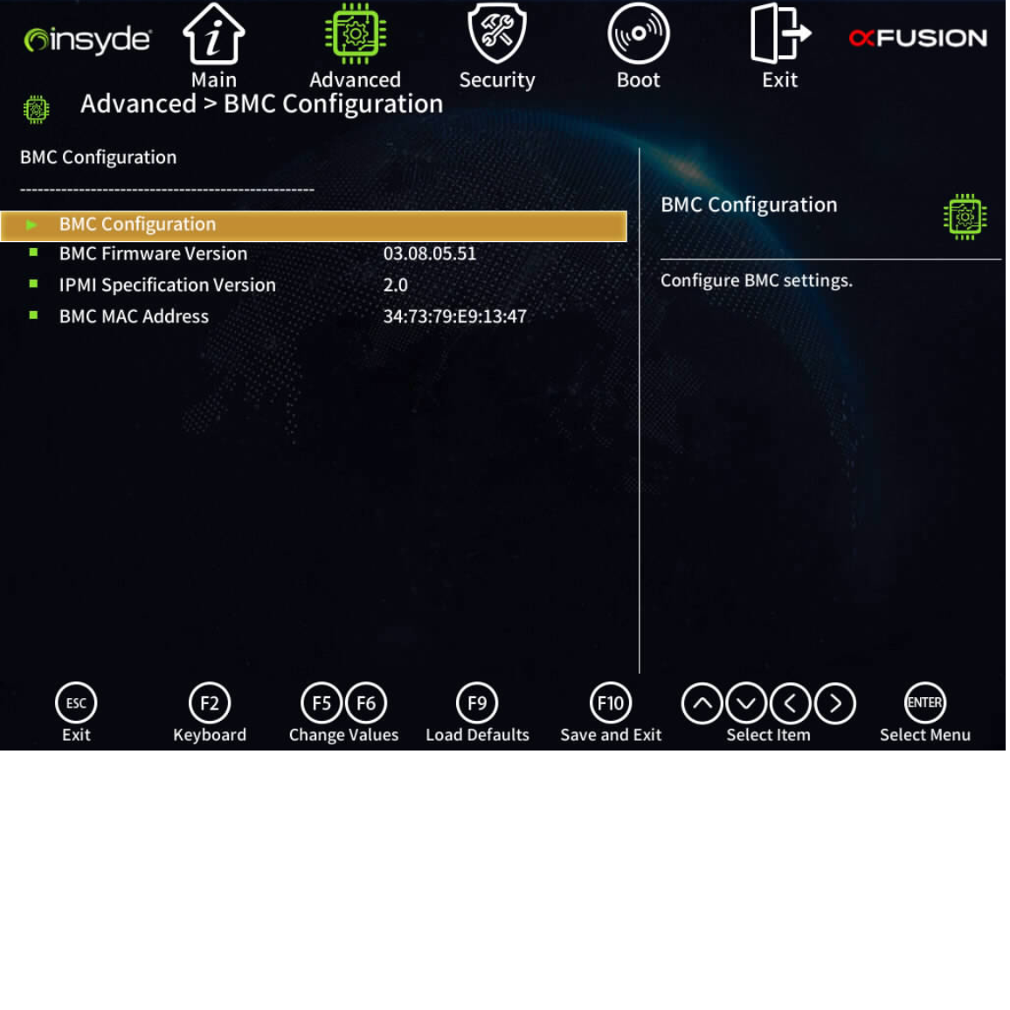
Management Features
BMC Set

Slide 38
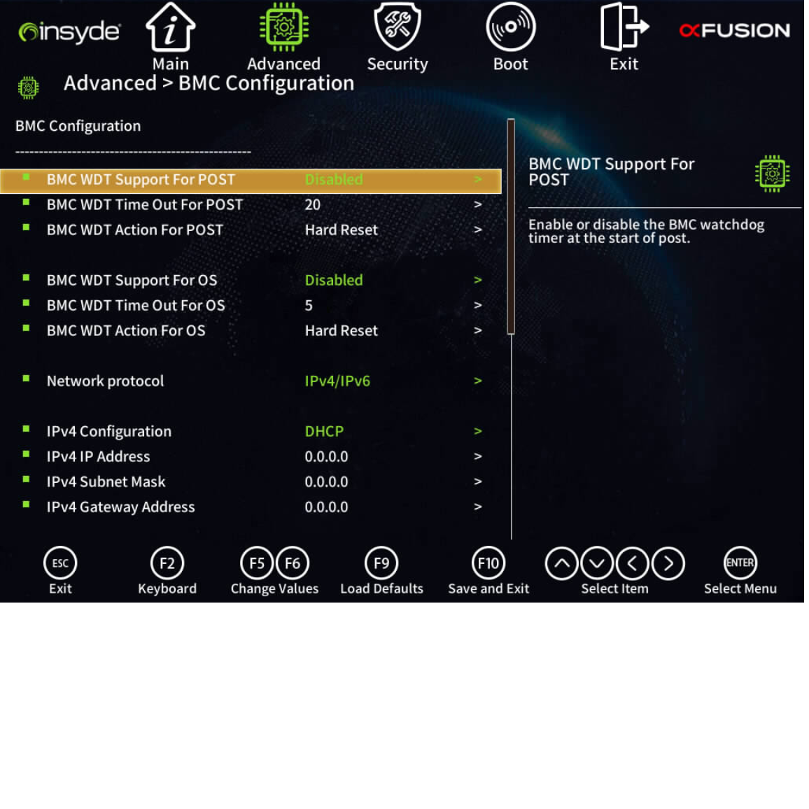
Management Features
BMC Set - IPv4 Configuration

Slide 39
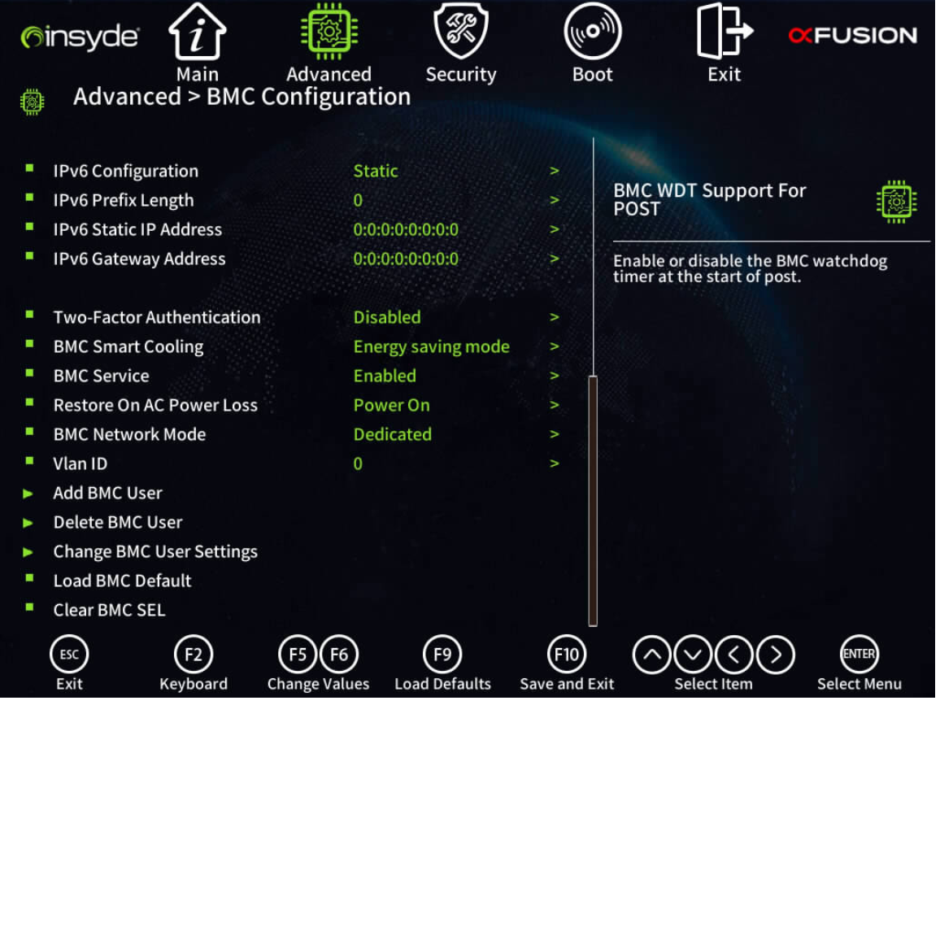
Management Features
BMC Set - BMC ID / PW 변경 가능

Slide 40
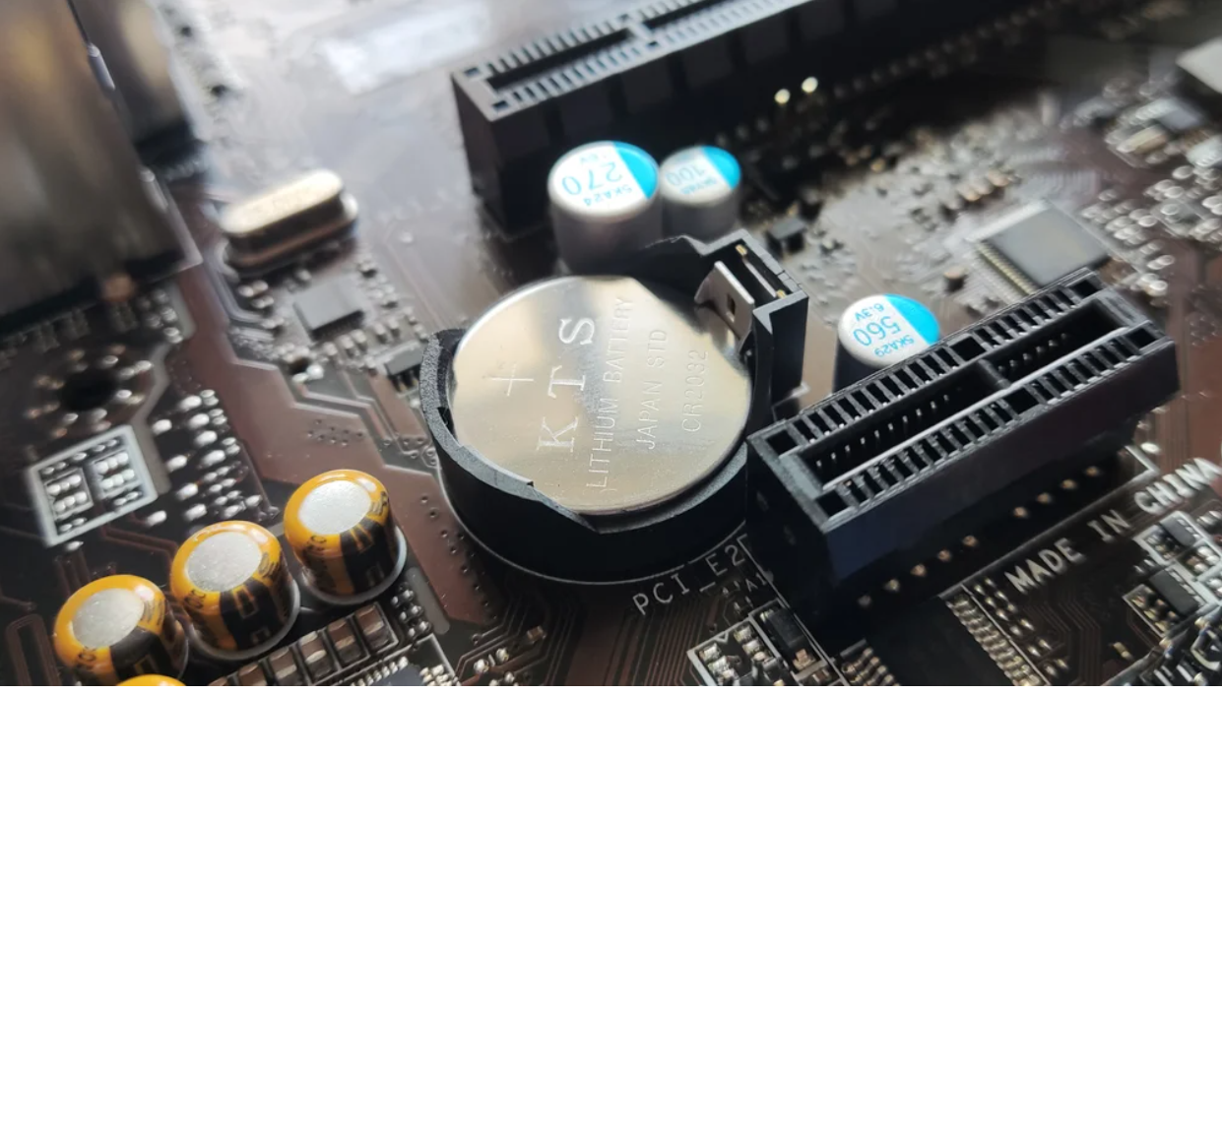
Trouble Shooting
BIOS Clear - Server MainBoard에 장착되어있는 CMOS 베터리를 5초간 분리한 후 다시 장착
Event Logging
Firmware Update

Slide 41
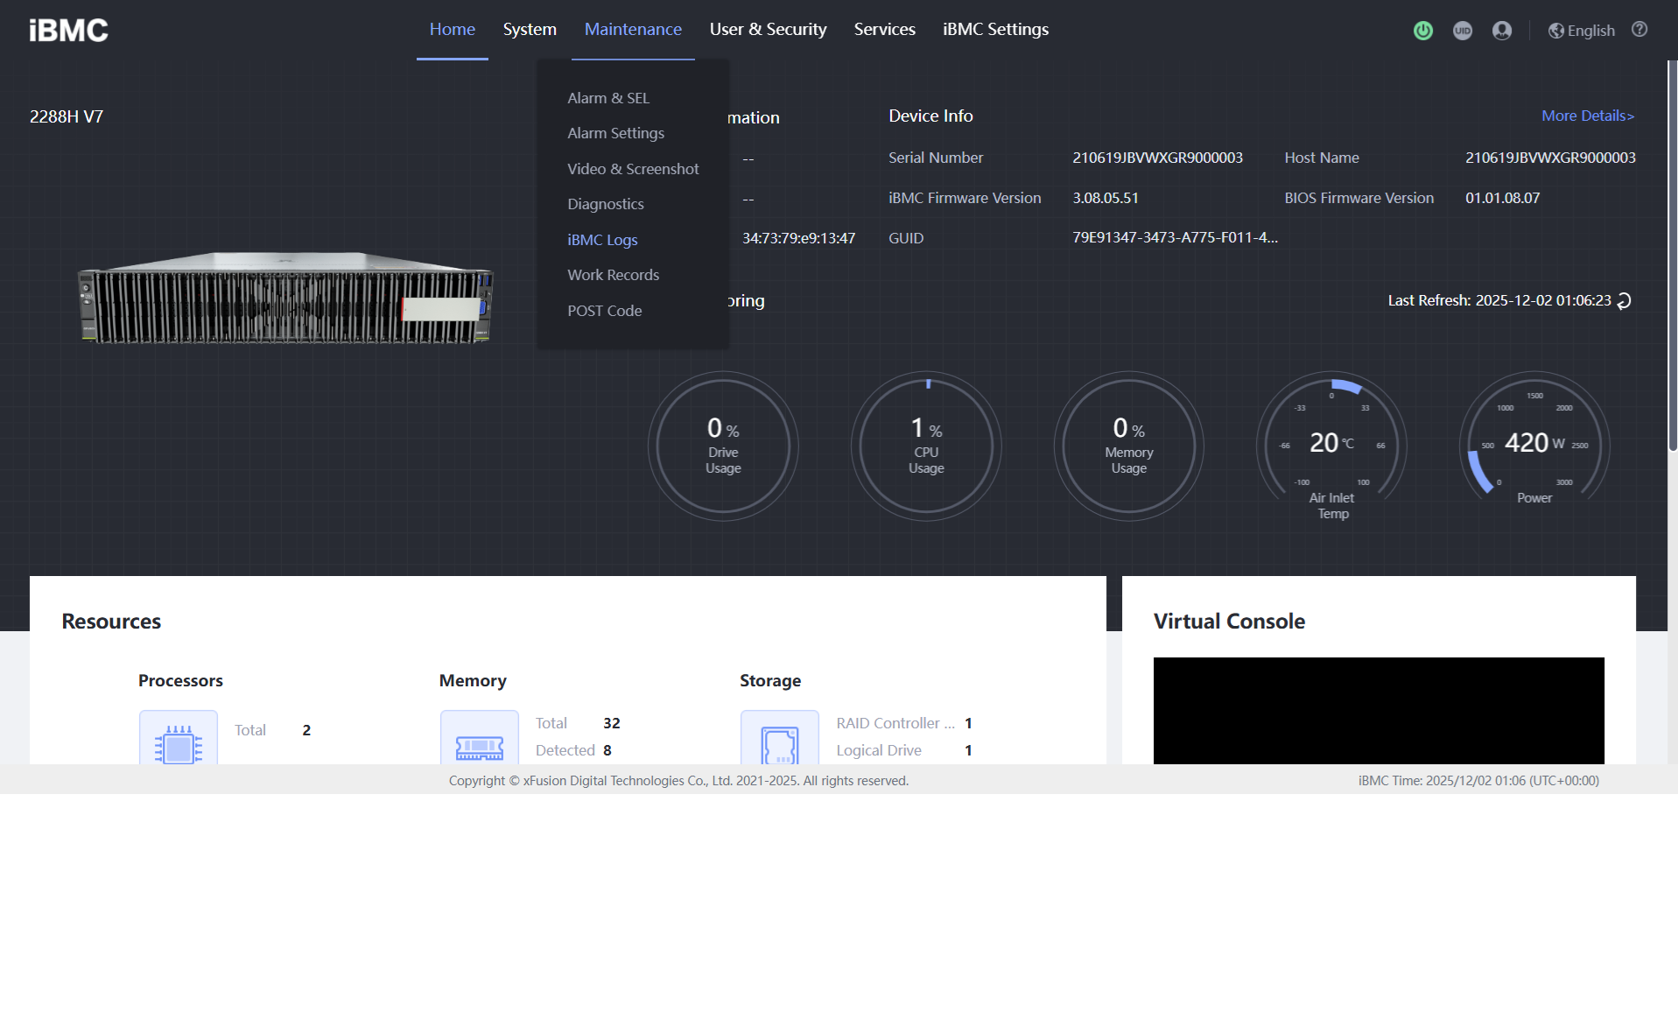
Trouble Shooting
BIOS Clear
Event Logging
Firmware Update

Slide 42
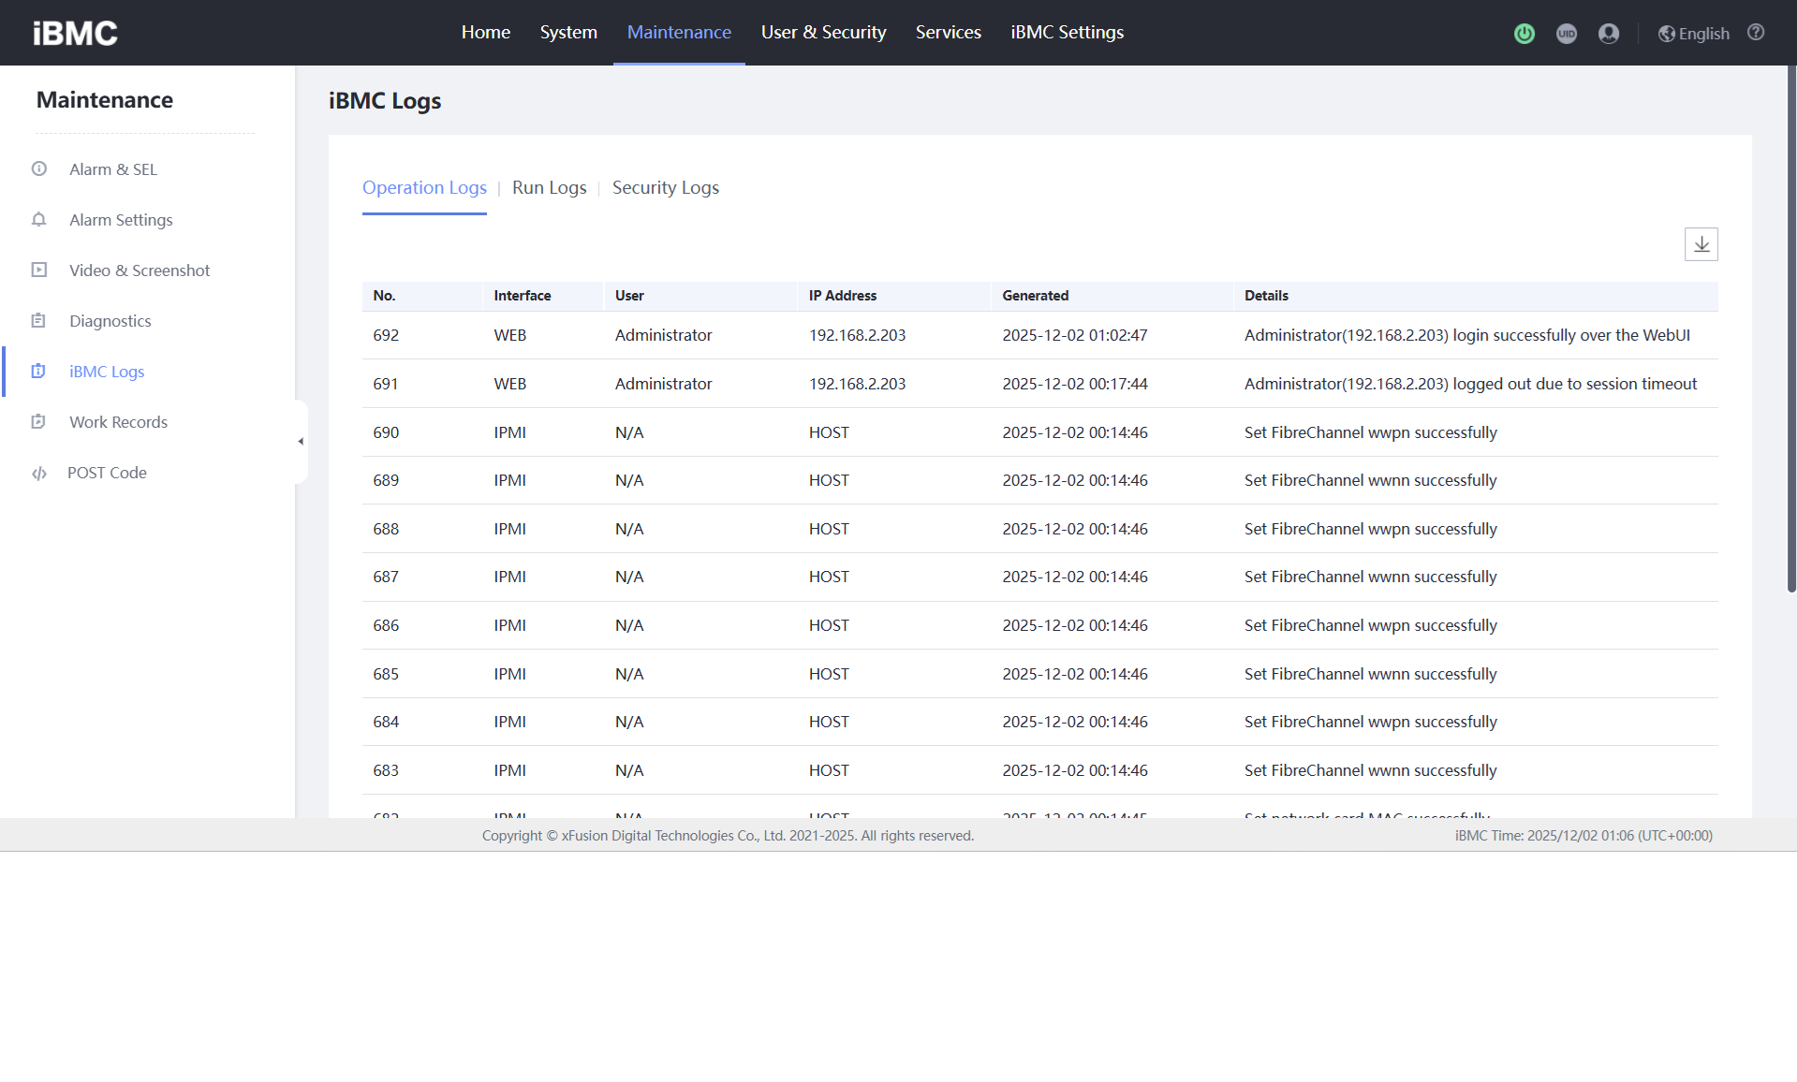
Trouble Shooting
BIOS Clear
Event Logging
Firmware Update

Slide 43
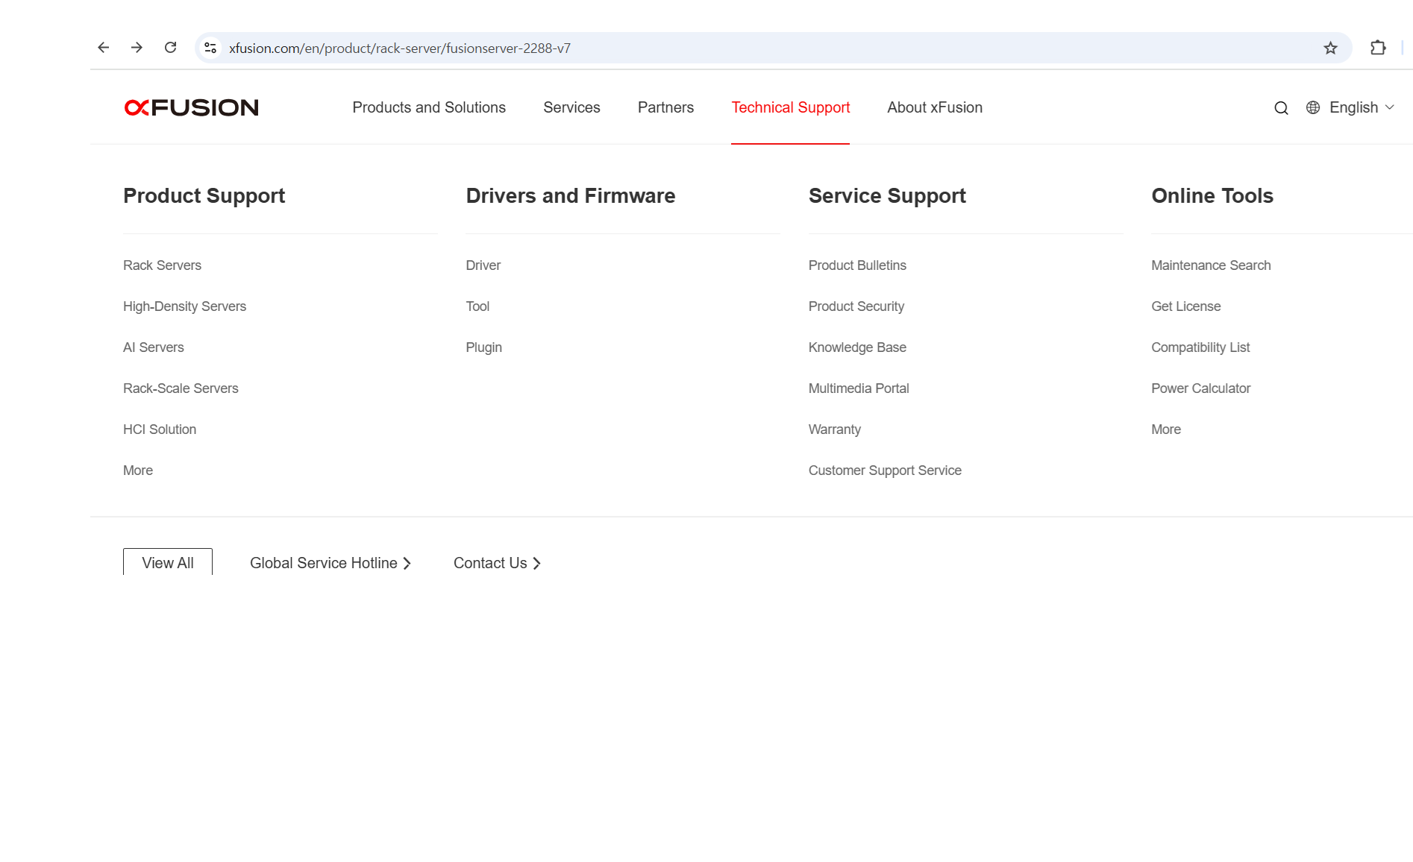
Trouble Shooting
BIOS Clear
Event Logging
Firmware Update - xFusion Web Technical Support 에서 Drivers and Firmware Driver Click

Slide 44
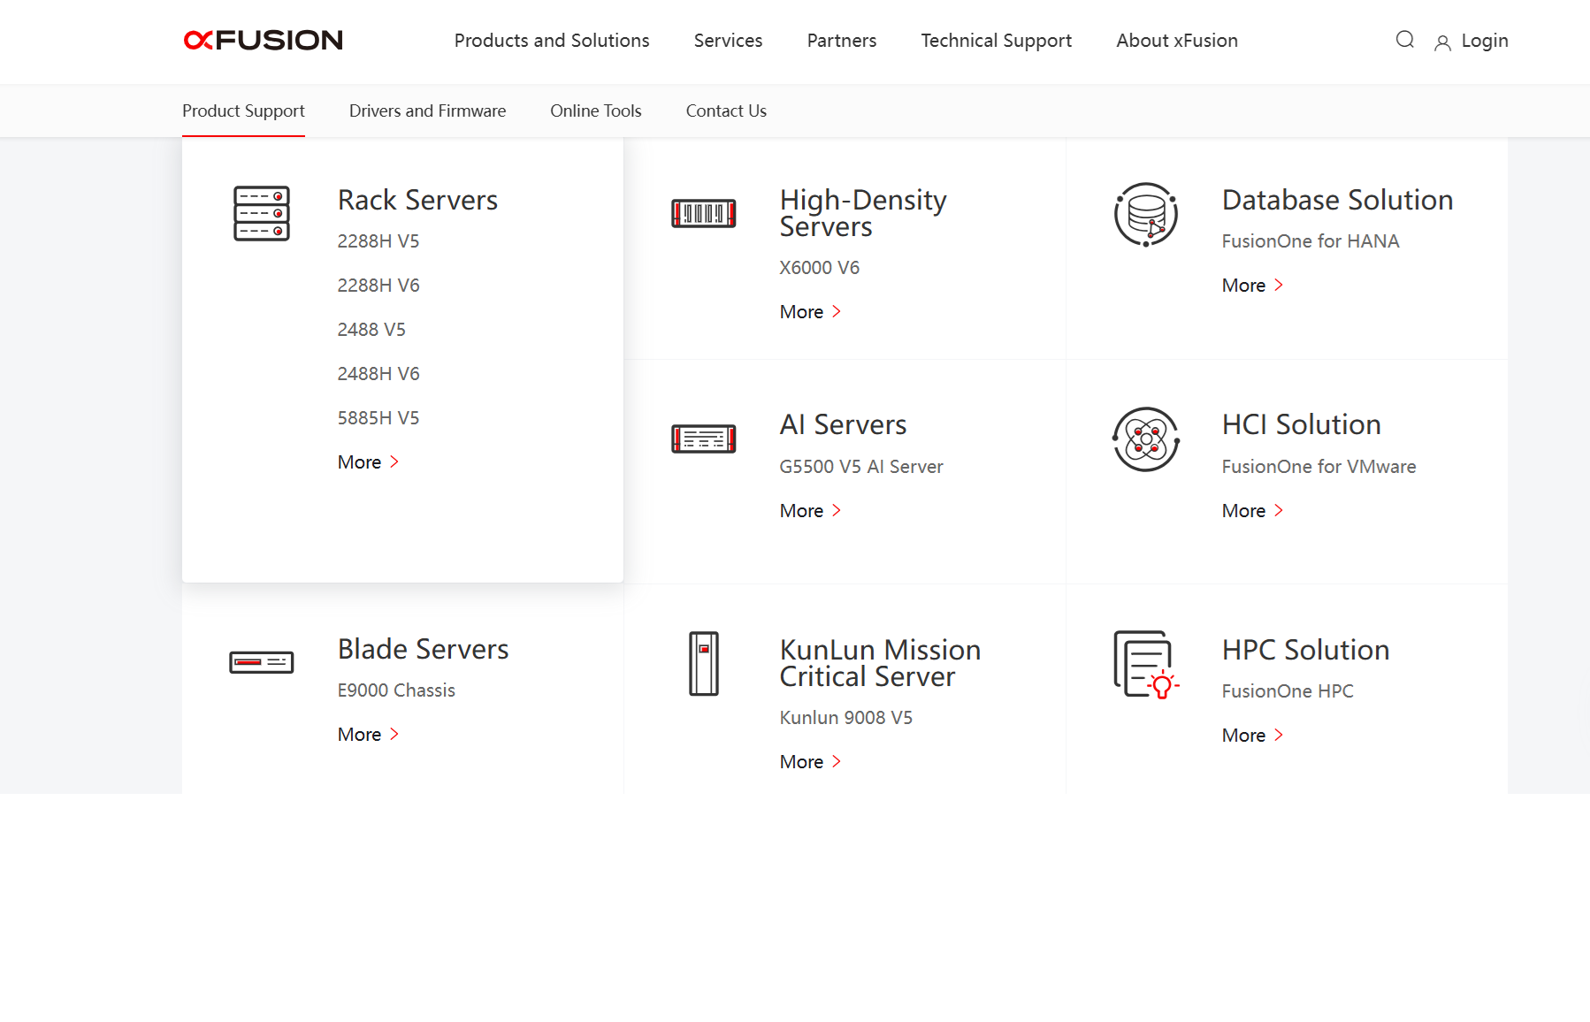
Trouble Shooting
BIOS Clear
Event Logging
Firmware Update - Rack Servers More Click 후 자신의 Server 를 선택

Slide 45
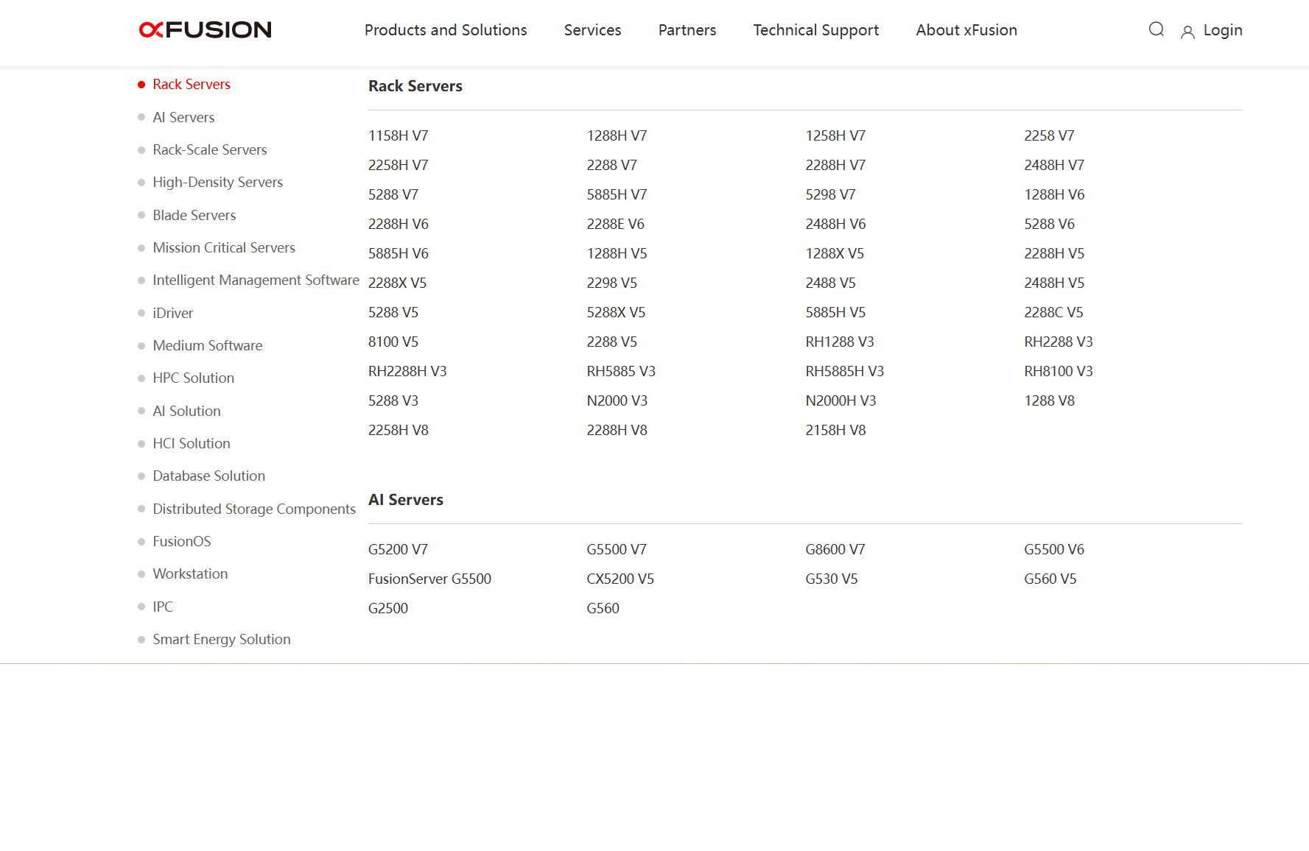
Trouble Shooting
BIOS Clear
Event Logging
Firmware Update - Rack Servers More Click 후 자신의 Server 를 선택

Slide 46
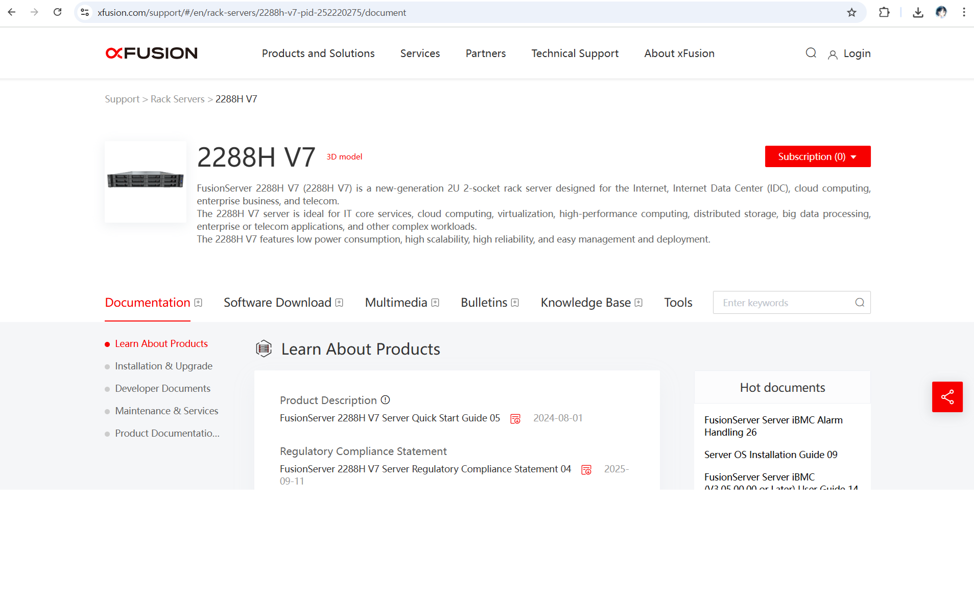
Trouble Shooting
BIOS Clear
Event Logging
Firmware Update - Software Download Click

Slide 47
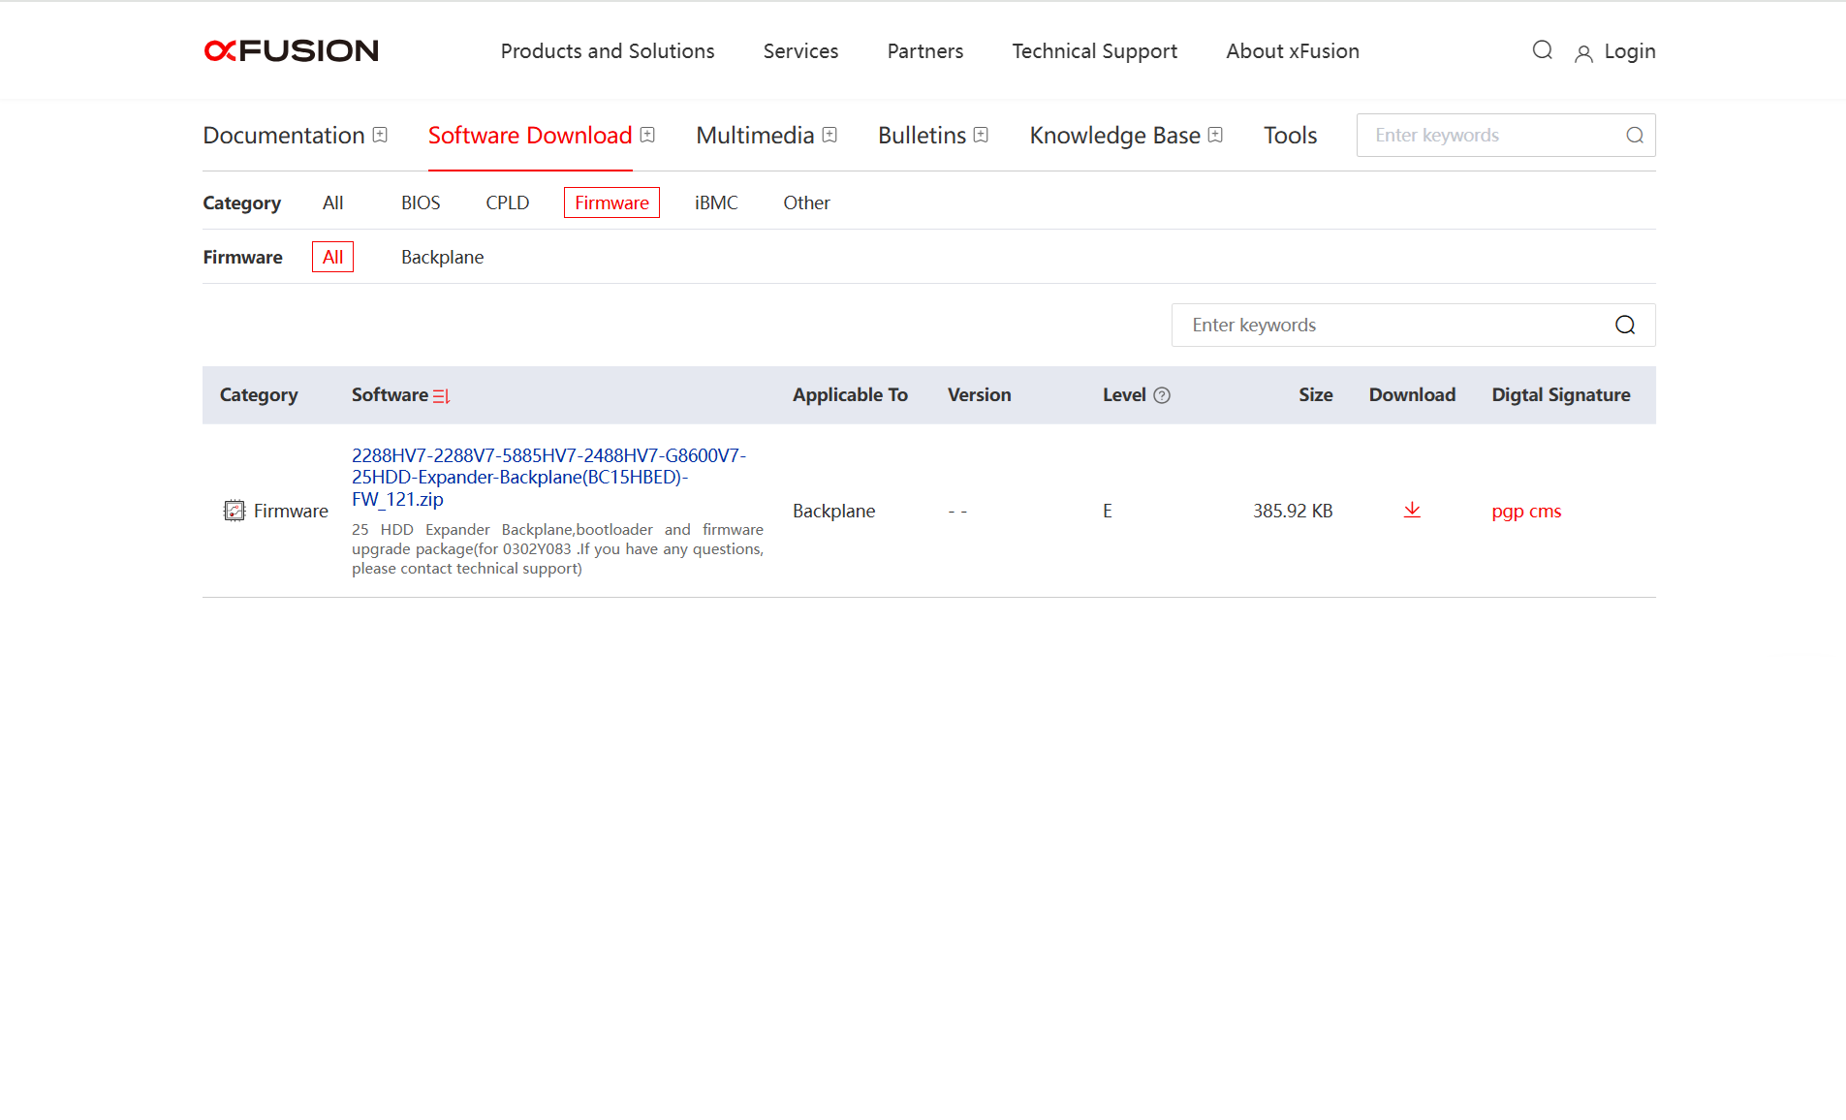
Trouble Shooting
BIOS Clear
Event Logging
Firmware Update - Server의 사양 및 버전과 맞는 Category 를 검색하여 Download

Slide 48
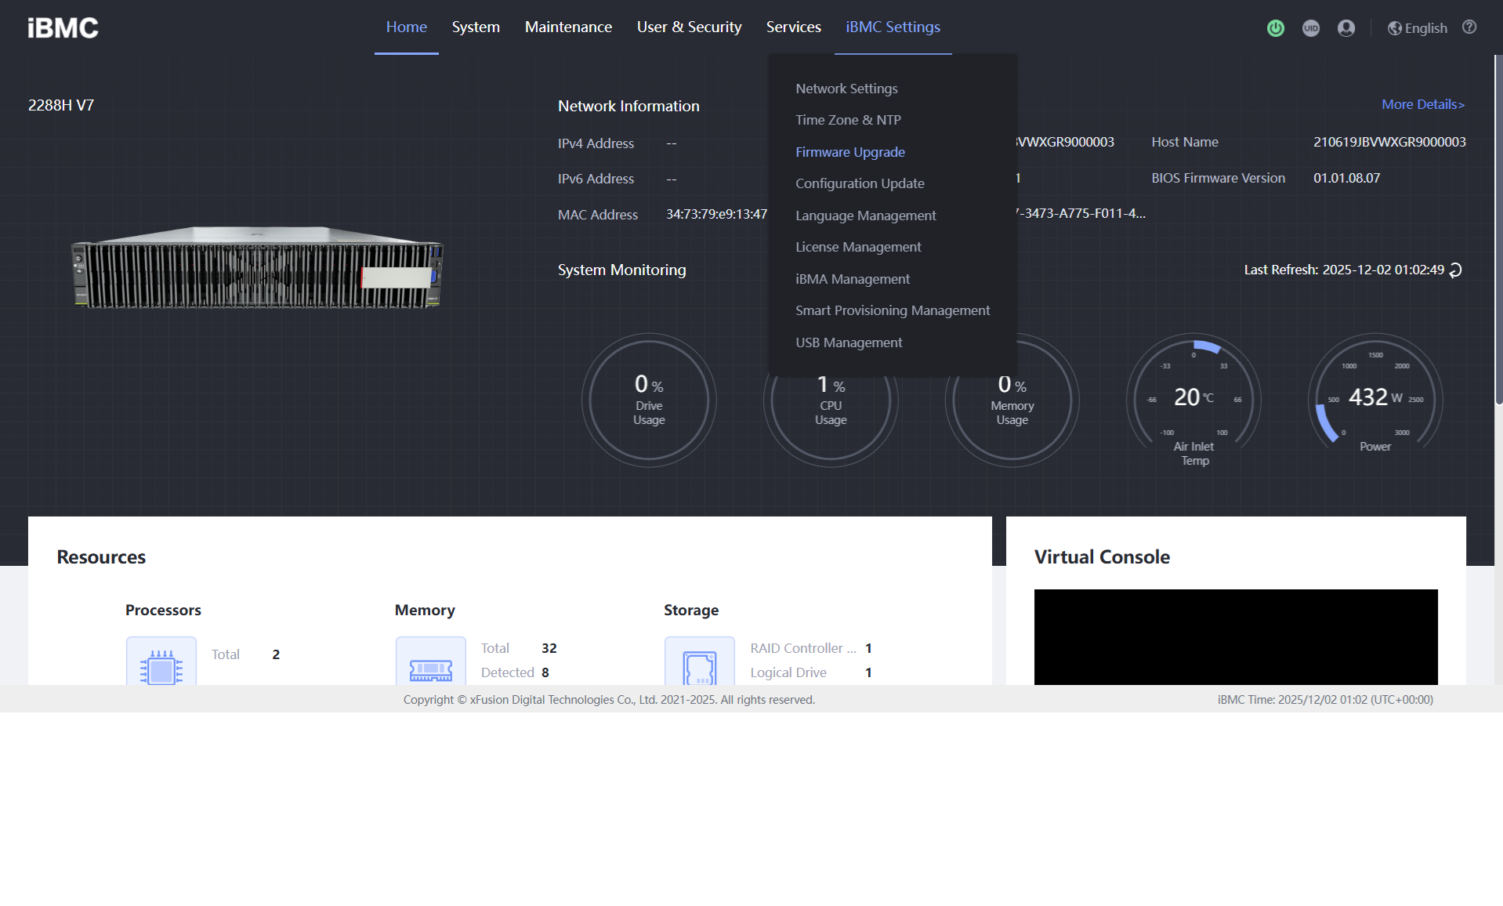
Trouble Shooting
BIOS Clear
Event Logging
Firmware Update

Slide 49
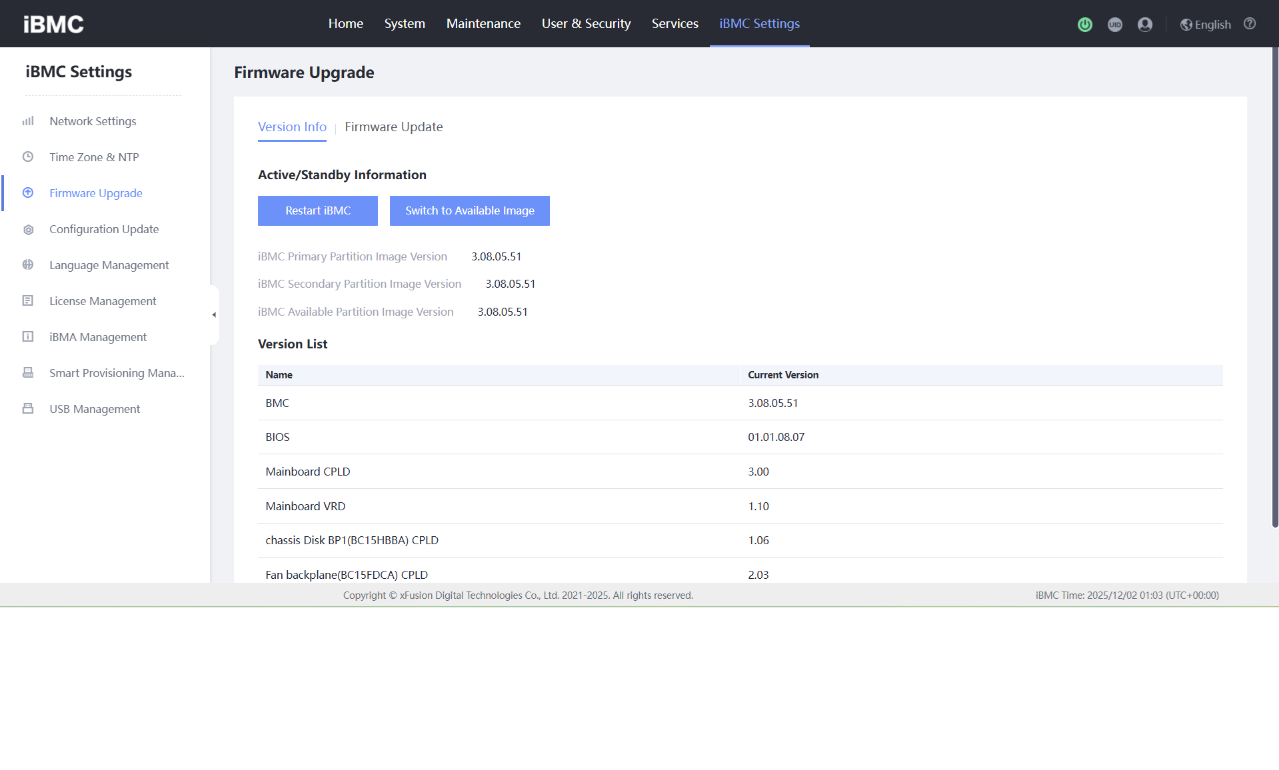
Trouble Shooting
BIOS Clear
Event Logging
Firmware Update

Slide 50
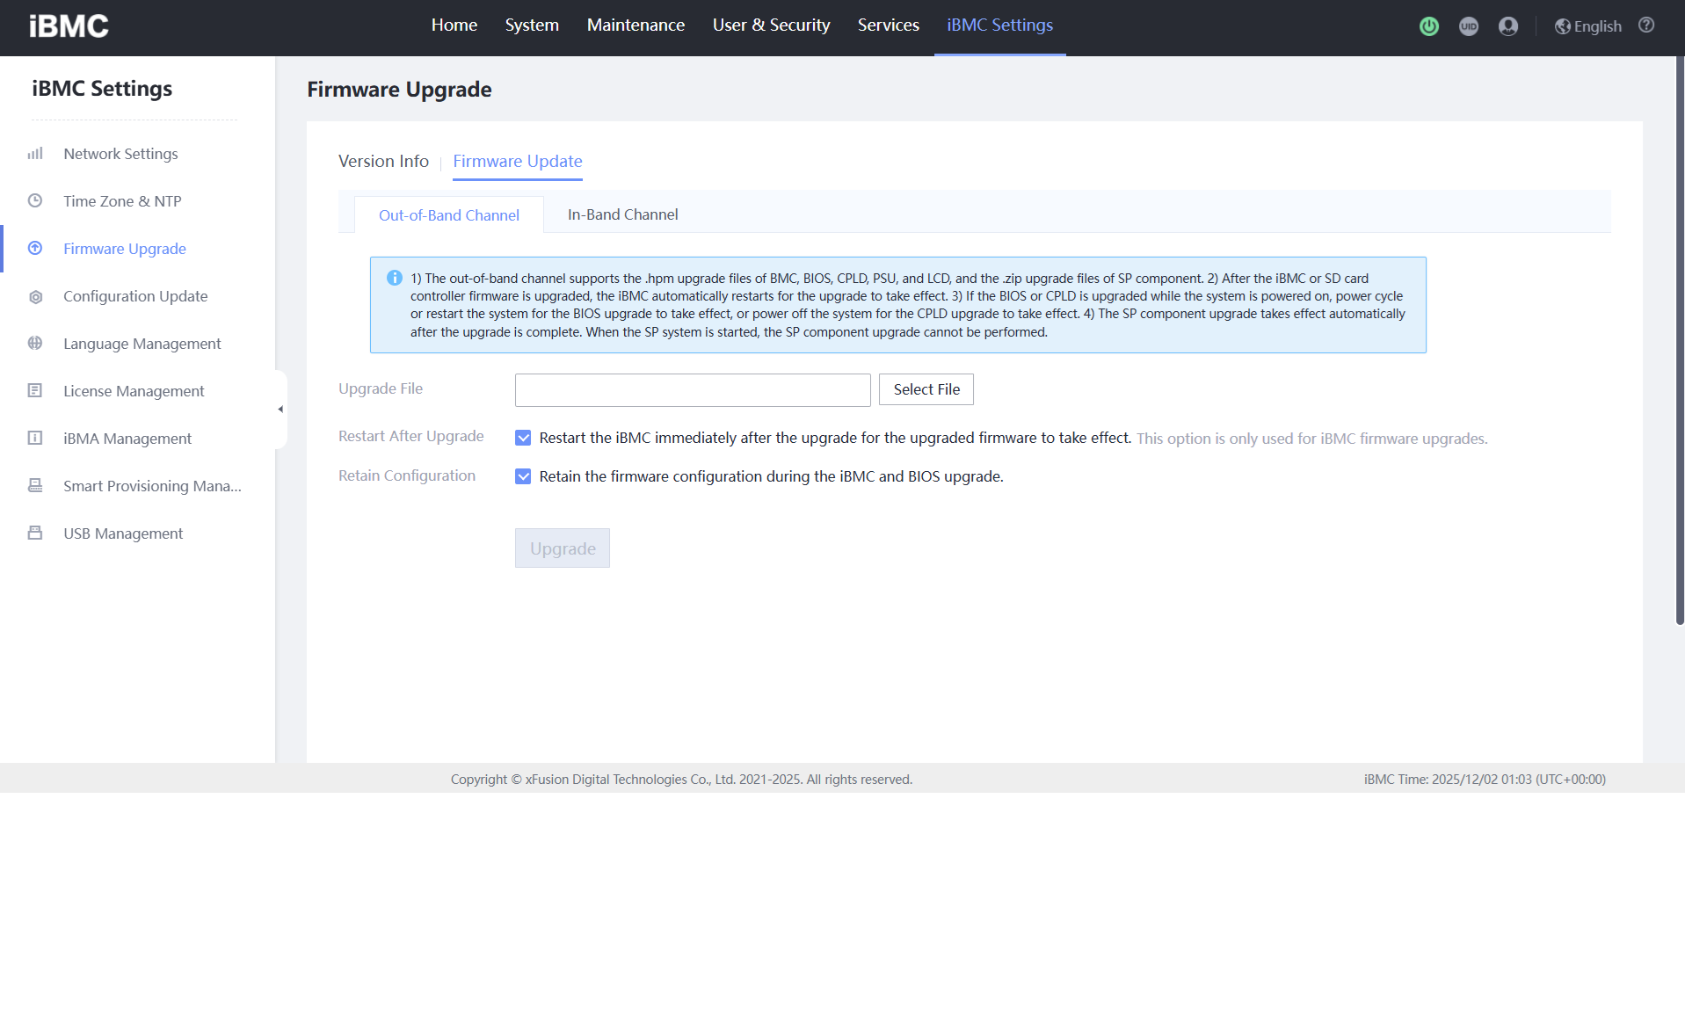
Trouble Shooting
BIOS Clear
Event Logging
Firmware Update - xFusion Site에서 다운 받은 압축 폴더를 올려준다.

